Slide 1
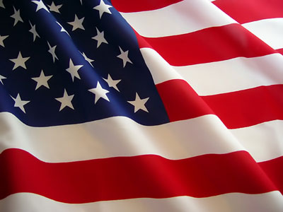
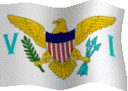
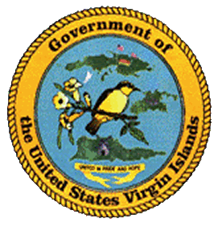


SEPTEMBER
HOLIDAYS CELEBRATIONS RECOGNITION
in the
VIRGIN ISLANDS of the UNITED STATES OF AMERICA
September
Labor Day … Monday, September 4th
Holidays observed by the
Virgin Islands of the United States of America
strengthen an important process in the development of the territory.
Compliments of:
Virgin islands department of education
Division of virgin islands
cultural education
Building Our Future Through
Education, History and Culture!

Slide 2
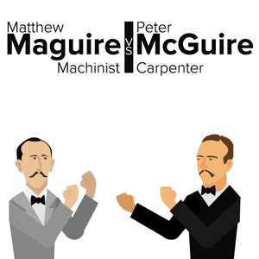
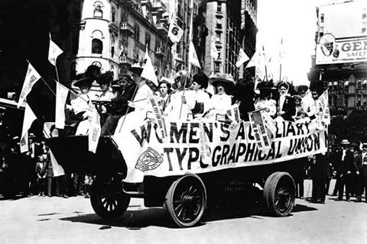
Labor Day
Born from the labor movement, Labor Day is a national holiday that is celebrated on the first Monday in September. It honors the social and economic achievements of American workers, which is a testament of the contributions workers have made to the strength, prosperity, and well-being of our country.
There are different opinions of who first proposed the holiday. Credit is given to general secretary of the Brotherhood of Carpenters and Joiners and cofounder of the American Federation of Labor, Peter J. McGuire for his suggestion of a day to honor those "who from rude nature have delved and carved all the grandeur we behold.“ While others believe that Matthew Maguire, a machinist, should rather receive accolades for founding the holiday. Research reveals that Matthew Maguire, later the secretary of Local 344 of the International Association of Machinists in Paterson, N.J., proposed the holiday in 1882 while serving as secretary of the Central Labor Union in New York.
Though its founder may remain debatable, what is proven is that the Central Labor Union adopted a Labor Day proposal and appointed a committee to plan a demonstration and picnic. Hence, the first Labor Day holiday was celebrated on Tuesday, September 5, 1882 in New York City, in accordance with the plans of the Central Labor Union. The Central Labor Union held its second Labor Day holiday on September 5, 1883. In 1884 the first Monday in September was selected as the holiday, as originally proposed, and the Central Labor Union urged similar organizations in other cities to follow the example of New York and celebrate a "workingmen's holiday" on that date. The idea spread with the growth of labor organizations, and in 1885 Labor Day was celebrated in many industrial centers of the country.
The first governmental recognition came through municipal ordinances passed during 1885 and 1886, which prompted a movement to secure state legislation. The first state bill was introduced into the New York legislature, but the first to become law was passed by Oregon on February 21, 1887. During the same year four more states - Colorado, Massachusetts, New Jersey, and New York - created the Labor Day holiday by legislative enactment. By the end of the decade Connecticut, Nebraska, and Pennsylvania followed. By 1894, 23 other states had adopted the holiday in honor of workers, and on June 28, 1894 Congress passed an act making the first Monday in September an annual legal holiday in the District of Columbia and the territories.
The form that the observance and celebration of Labor Day should take was outlined in the first proposal of the holiday — a street parade to exhibit to the public the strength and “
esprit de corps” of the trade and labor organizations of the community, followed by a festival for the recreation and amusement of the workers and their families. This became the pattern for the celebrations of Labor Day. Speeches by prominent men and women were introduced later, as more emphasis was placed upon the economic and civic significance of the holiday. Still later, by a resolution of the American Federation of Labor convention of 1909, the Sunday preceding Labor Day was adopted as Labor Sunday and dedicated to the spiritual and educational aspects of the labor movement.
While the mainland Labor Day marks the end of the summer season and a final opportunity to make trips, hold outdoor events, and sales, the Virgin Islands of the United States of America celebrates Labor Day with family and friends, relaxing, enjoying barbecues and beach picnics.

Slide 3
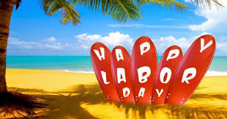
Suggested Family and Classroom Activities:
Perform your own research on the history and significance of Labor Day
Participate in a Labor Day event
Plan and orchestrate a Labor Day event for some family and friends
Creatively share your findings from your research, your organization of the event, and/ or experience in the participation of an event
Courtesy of
Text: https://www.dol.gov/laborday/history.htm
Pictures: https: //www.askideas.com/media/30/Hope-You-Too-Had-A-Rejuvinating-Labor-Day-Weekend.jpg

Slide 4
To receive complimentary monthly electronic holidays celebrations recognition, kindly contact …
VIRGIN ISLANDS DEPARTMENT OF EDUCATION
DIVISION OF VIRGIN ISLANDS CULTURAL EDUCATION
ST. CROIX
2133 Hospital Street; St. Croix, VI 00820
Telephone Number: 340-773-1095 x: 7032
Fax Number: 340-773-4476
ST. THOMAS / ST. JOHN
Mailing Address: 1834 Kongens Gade; STT, VI 00802
Physical Address: J. Antonio Jarvis Annex; STT, VI 00802
Telephone Number: 340-774-0100 x: 2808, 2806, or 2804
Fax Number: 340-777-4342
Email Addresses: valrica.bryson@vide.vi; yohance.henley@vide.vi; maria.martin@vide.vi
Building Our Future Through
Education, History and Culture!

