Slide 1
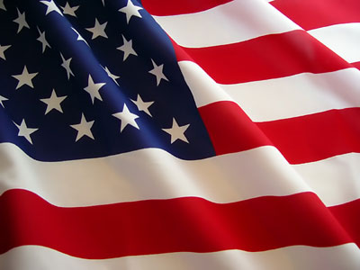




SEPTEMBER 2017
HISTORICAL CULTURAL CALENDAR
DEPARTMENT OF EDUCATION
DIVISION OF VIRGIN ISLANDS CULTURAL EDUCATION

Slide 2
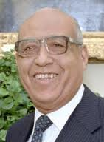
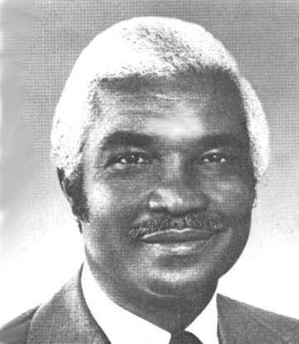
SPECIAL TRIBUTE TO THE
EIGHT ELECTED GOVERNORS OF THE USVI
Dr. Melvin Herbert Evans
1969 - 1975
Cyril Emmanuel King
1975 - 1978
Pictures Courtesy of:
Dr. Melvin Herbert Evans: http://ookaboo.com/o/pictures/picture/2447977/A_picture_of_Melvin_H_Evans
Cyril Emmanuel King: http://www.stx.k12.vi/profiles/kingc.htm

Slide 3
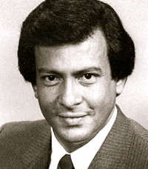
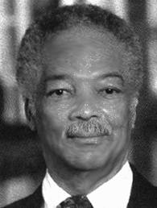
SPECIAL TRIBUTE TO THE
EIGHT ELECTED GOVERNORS OF THE USVI
Juan Francisco Luis
1978 - 1986
Alexander Anthony Farrelly, Esquire
1987 - 1994
Pictures Courtesy of:
Juan Francisco Luis: http://stcroixsource.com/content/news/local-news/2011/06/05/former-gov-juan-f-luis-dies-70
Alexander Anthony Farrelly, Esquire: http://www.stx.k12.vi/profiles/FARRELLY.htm

Slide 4
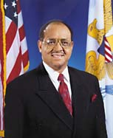
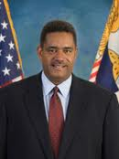
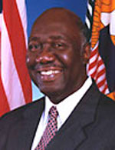
SPECIAL TRIBUTE TO THE
EIGHT ELECTED GOVERNORS OF THE USVI
Dr. Roy Lester Schneider
1995 – 1998
John Percy deJongh, Jr.
2007 - 2015
Charles Wesley Turnbull, Ph.D.
1999 - 2006
Pictures Courtesy of:
Dr. Roy Lester Schneider: http://www.usvi.net/usvi/activities/rolex/html/welcome.html
Charles Wesley Turnbull, Ph.D.: http://www.nndb.com/people/442/000044310/
John Percy deJongh, Jr.: http://2007.southerngovernors.org/Governors/USVIJohndeJonghJr.aspx

Slide 5
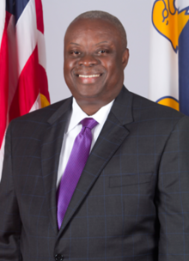
SPECIAL TRIBUTE TO THE
EIGHT ELECTED GOVERNORS OF THE USVI
Kenneth Mapp
2015 - Present
Pictures Courtesy of:
Kenneth Mapp : http://governormapp.com/office-of-the-governor/governor-mapp/

Slide 6
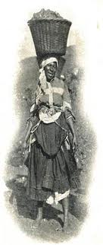
September 1st:
1892:
Queen Coziah led 200 coal laborers and protested through Charlotte Amalie demanding higher wages at full currency value rates.
Text: The Umbilical Cord by Harold W. L. Willocks, page 222
Picture: http://www.myspace.com/dollarfodollar

Slide 7

September 2nd:
1994:
Governor Alexander A. Farrelly and the 20th Legislature of the U.S. Virgin Islands passed Act 6012 to create the V.I. Hospital and Health Facilities Corporation. It was established to ensure that quality, comprehensive health care is available to residents and visitors throughout the territory.
Text and picture: http://www.jflusvi.org/history.php and http://www.governordejongh.com/budget/fy2012/docs/hospital.pdf
Picture: http://www.governordejongh.com/budget/fy2012/docs/hospital.pdf

Slide 8
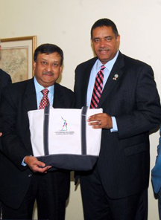
September 3rd:
2010:
Governor de Jongh Jr. welcomed India’s Consul General in New York, Ambassador Prabhu Dayal, to Government House on St. Thomas. The two leaders discussed India's relationship with the United States, focusing on the key issues of education, energy, environment, empowerment, economy, educational exchanges between the two nations; building a talent base at the University of the Virgin Islands for top-level careers; the Research and Technology Park; and possibilities for partnerships in high tech and light manufacturing sectors.
Text & Picture: http://www.governordejongh.com/blog/2010/09/indias-counsel-general-calls-on-government-house.html

Slide 9
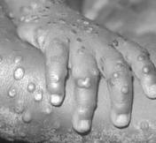
September 4th:
1749:
The small pox plague in St. Croix ended after about twelve days after taking the lives of a number of residents.
Text: A Caribbean Mission, C.G.A. Oldendorp, Page 464
Picture: http://blogs.discovermagazine.com/80beats/2010/08/

Slide 10
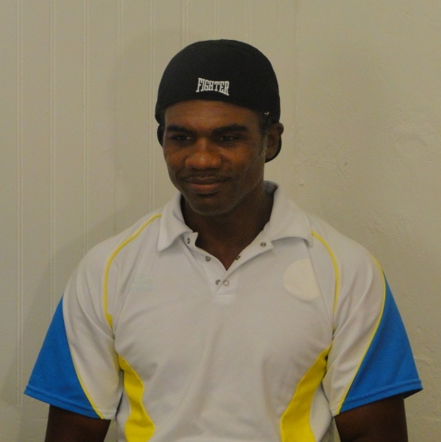
September 5th:
1990:
The road, which stretches from Bournefield to Brewers Bay, was renamed the Julian Jackson Drive in honor of the World Boxing Legend and Hall of Famer.
Text: Legislative Archives
Picture: Division of Virgin Islands Cultural Education

Slide 11
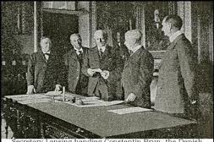
September 6th:
1679:
The Danish West Indies and Guinea Company elected Nicholaj Esmit as governor of the colony. He replaced Iversen.
Text: The Umbilical Cord, Harold W. L. Willocks, Page 62
Picture: http://www.stjohnhistoricalsociety.org/Articles/Acquisition.htm

Slide 12
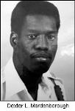
September 7th:
1964:
Police Officer Dexter L. Mardenborough was born on St. Kitts, West Indies. Posthumously the VI Medal of Honor was conferred on him; he was mortally wounded in the line of duty. He was selected as an “Outstanding Young Man of America” in 1989 for his outstanding professional achievement, superior ability and exceptional service to his community.
Text: Legislature Archives
Picture: http://www.vipd.gov.vi/About_Us/History/In_Memoriam.aspx

Slide 13
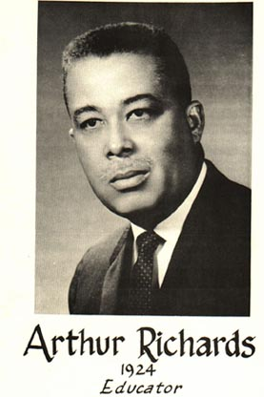
September 8th:
1924:
Arthur A. Richards was born on St. Croix, USVI. A distinguished educator, he was the first Virgin Islander to serve as president of the then College of the Virgin Islands.
Text & Picture: Profiles of Outstanding Virgin Islanders, Ruth Moolenaar, Page 184

Slide 14
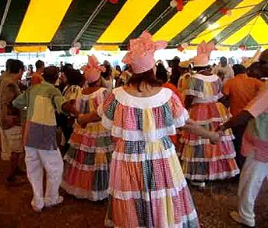
September 9th:
1895:
Eliza James McBean, who spent most of her life in F’Sted, St. Croix and lived to the age of 105, was born. She was honored in 1990 at age 98 by the St. Croix Heritage Dancers for her contribution to quadrille dance and culinary arts.
Text: A Musical Journey and Other Stories, Richard A. Schrader, Sr., Page 168-187
Picture: http://findallvideo.com/tag/quadrille-dance

Slide 15

September 10th:
2002: Native of Frederiksted, St. Croix, Alexander Anthony Farrelly passed away in Arlington, Virginia. He was the territory’s 4th elected governor of the US Virgin Islands, veteran, and an attorney.
Text: Legislature Archives
Picture: http://the-sacredalchemist.tripod.com/page4.html

Slide 16
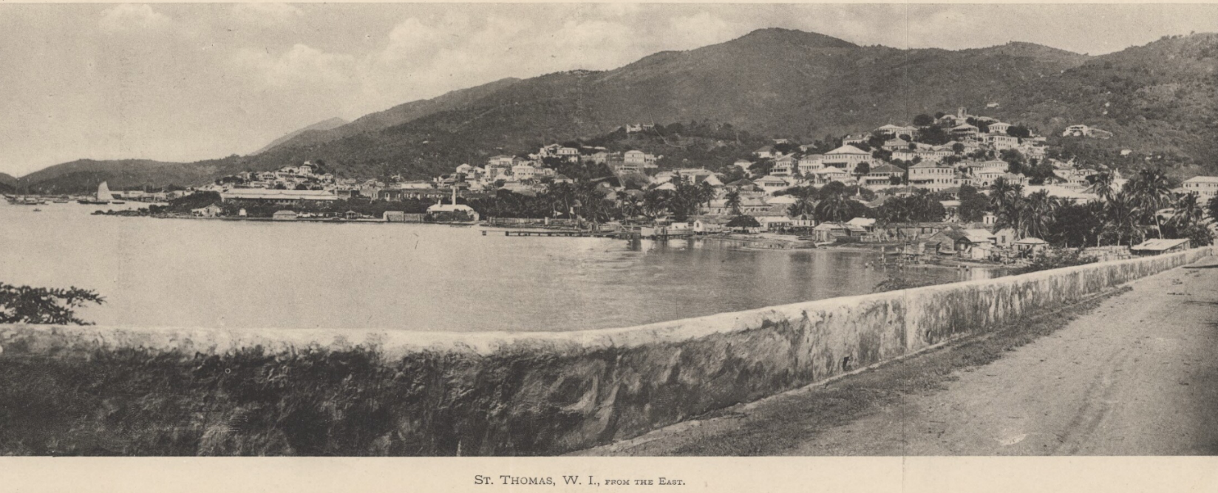
September 11th:
1695: The town of Charlotte Amalie was enlarged with a street that ran along the sea.
Text & Pictures: https://www.youtube.com/watch?v=fIII2Cjkr_w

Slide 17
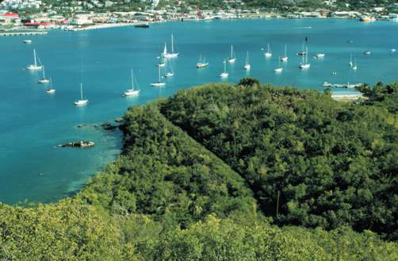
September 12th:
1996:
Interior Secretary Bruce Babbitt announced an agreement between the Federal and Territorial Governments to transfer Water Island from the federal to the local government.
Text:
Picture: http://www.nps.gov/seac/wi/wi-report.htm

Slide 18
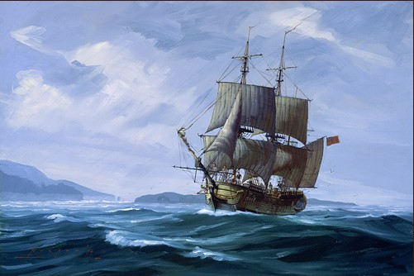
September 13th:
1733:
The Brethren voyage from Stettin to Copenhagen carried a total of 18 people. Some were intended to be settlers for St. Croix and others as reinforcements for the mission on St. Thomas.
Text: A Caribbean, C.G.A. Oldendrop, page 292
Picture: http://paulinespiratesandprivateers.blogspot.com/2010/05/ships-voyage-of-discovery.html

Slide 19
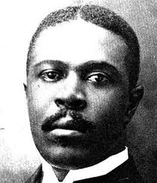
September 14th:
1916:
Liberator D. Hamilton Jackson was found guilty of libeling Governor Helweg-Larsen. He was ordered to pay a fine of 2,500 francs “having said at a public meeting where 800 to 900 persons were present, that the Governor had told an untruth ‘shameless as he is’ and that he could not respect a man who can speak untruth”.
Text: Rothschild Francis and Freedom of the Press in the USVI Islands, by William W. Boyer, page 3
Picture: http://stcroixsource.com/content/news/local-news/2010/10/31/territory-celebrates-d-hamilton-jackson-day

Slide 20
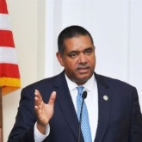
September 15th:
2009: Gov. John P. deJongh has taken action on a number of bills passed recently by the 28th Legislature. Some bills were signed into law, others were vetoed and the governor acknowledged three resolutions passed by the Senate.
Pictures: http://viconsortium.com/politics/these-are-the-bills-governor-de-jongh-took-action-on-in-october/

Slide 21
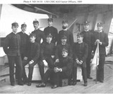
September 16th:
1922:
The last day of Rear Admiral Sumner Ely Kittele’s term as governor. His term yielded complaints of civil abuses and atrocities that went ignored and without redress.
Text:
Picture: http://records.ancestry.com/Loise_Kittelle_records.ashx?pid=30090500

Slide 22
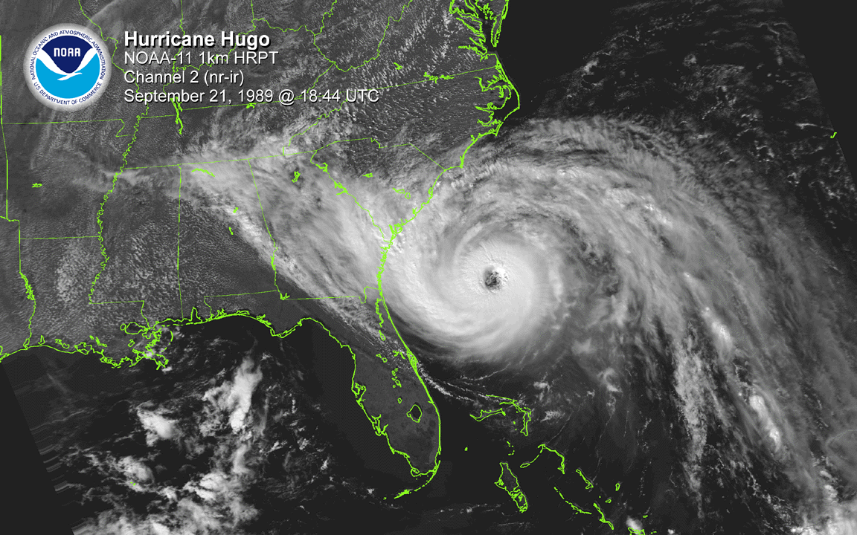
September 17th:
1989: Hurricane Hugo hit for two days causing far more devastation to St. Croix than any of the other islands.
Text: Today in VI History
Picture: https://www.weather.gov/chs/HurricaneHugo-Sep1989

Slide 23
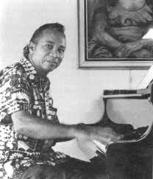
September 18th:
1974:
Resolution No. 722 passed to honor and congratulate Wilbur “Bill” LaMotta for his achievements in music.
Text: Legislative Archives
Picture: http://www.stx.k12.vi/Profiles/lamottaB.htm

Slide 24
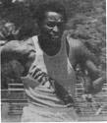
September 19th:
1974:
Resolution No. 722 was passed to honor Carl Plaskett for outstanding performance in track and field internationally.
Text: Legislative Archives
Picture: http://www.stx.k12.vi/profiles/Plaskett.htm

Slide 25
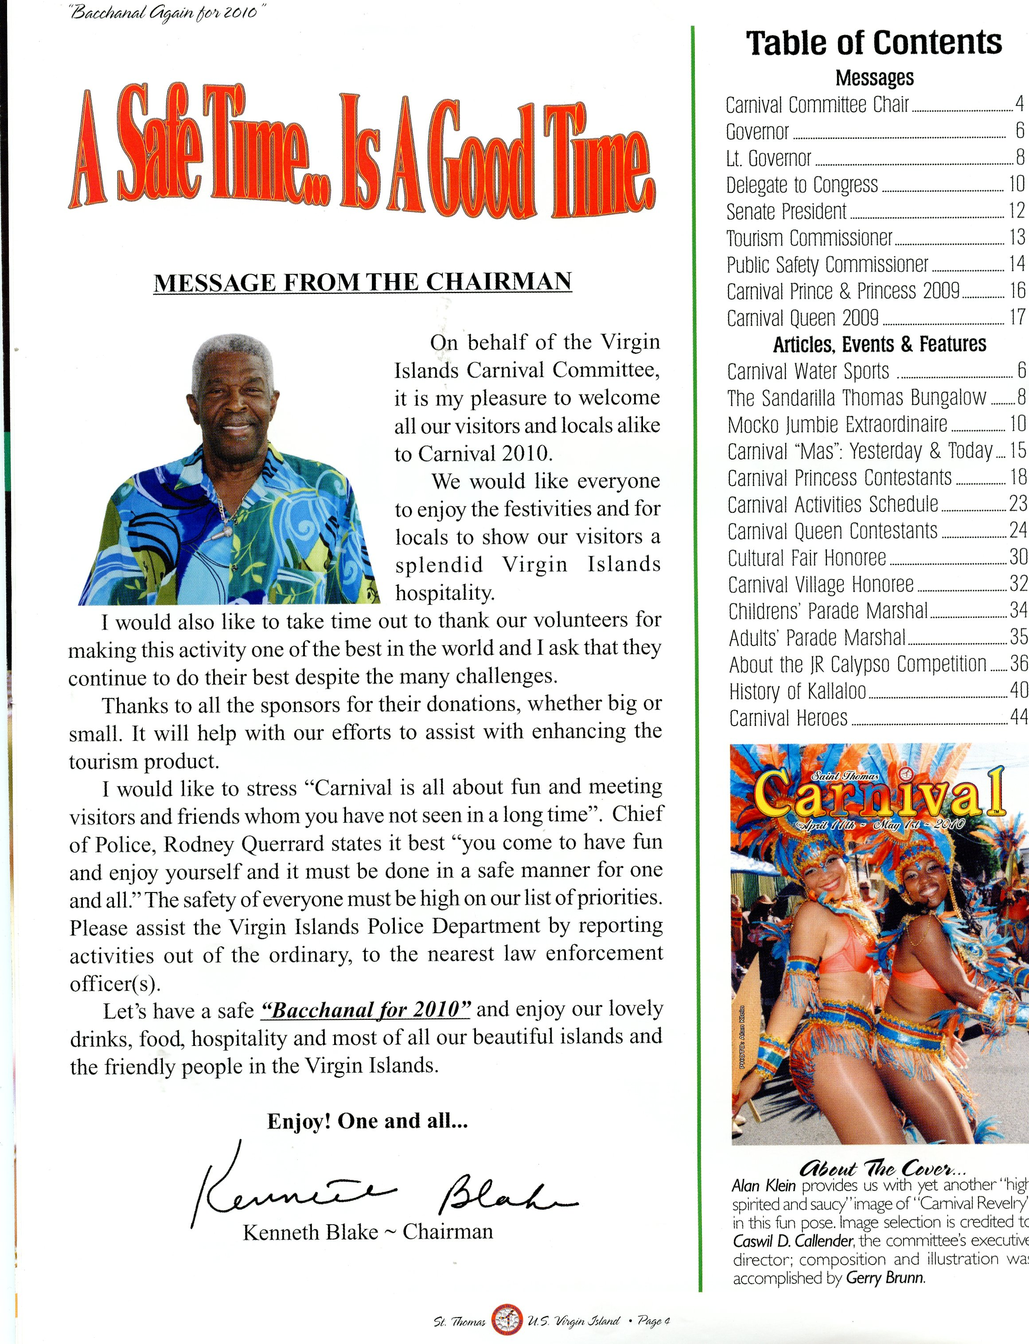
September 20th:
1979:
Resolution No. 992 passed to honor Kenneth Blake, Sr. “Lord Blakie” as the 1979 “Calypso King of the World”.
Text: Legislative Archives
Picture: St. Thomas Carnival, April 11th – May 1st 2011 Booklet, Page 4

Slide 26
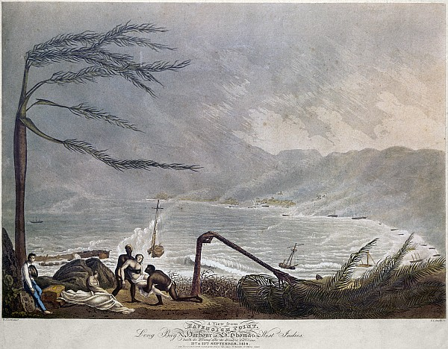
September 21st:
1819:
A major hurricane struck and crashed ships into the harbor and against the hills. It lasted for two days.
Text: Daily News 40th Anniversary Edition, Page 61
Picture: http://fineartamerica.com/featured/st-thomas-hurricane-1819-granger.html

Slide 27
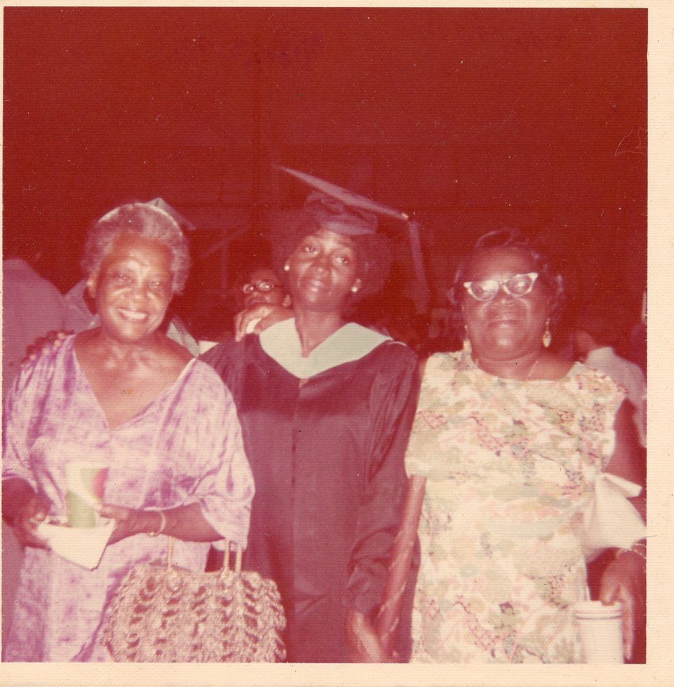
September 22nd:
1897:
Wilhelmina B. Lewis was born in the Dominican Republic. A noted political and civic activist in the United States and Virgin Islands, she initiated the first bus boycott in St. Petersburg, Florida in 1942, about thirteen years before Rosa Parks.
Text:
Picture: Division of Virgin Islands Cultural Education

Slide 28
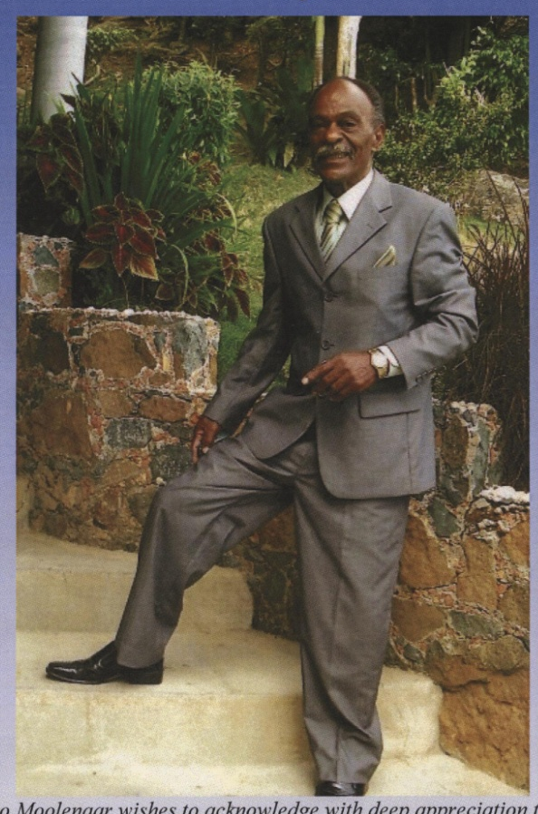
September 23rd:
1948:
Hugo Leanzo Moolenaar, Sr. ‘The Mocko Jumbie Man’ was born on St. Thomas. Veteran of the US Army, he was the recipient of a Purple Heart for his service and a valor to Vietnam.
Text & Picture: Funeral Booklet

Slide 29
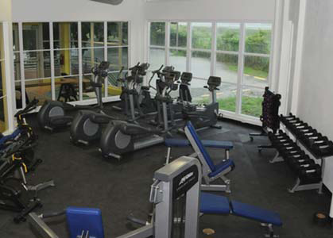
September 24th:
2010:
The University of the Virgin Islands (UVI) held its grand opening for the UVI Wellness Center on the St. Thomas campus. The $2.62 million 6,250 square-foot new building houses a mirrored aerobics and dance studio with a sprung wood floor, a fitness equipment room with weight training and cardiovascular equipment, and men’s and women’s locker rooms.
Text & Picture: http://www.uvi.edu/sites/uvi/Publications/dl_Sept_2010.pdf

Slide 30
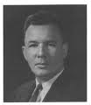
September 25th:
1958:
John D. Merwin, first native born governor of the VI, took office. During his tenure, tourism increased dramatically, improvements were made at Alexander Hamilton Airport, roads, highways, and buildings were renovated, and portable water line and sewer were extended to various part of town.
Text: The Umbilical Cord, Harold W.L. Willocks, Page 332
Picture: http://webpac.uvi.edu/imls/pi_uvi/profiles1992/Governors/Merwin_JD/index.shtml

Slide 31
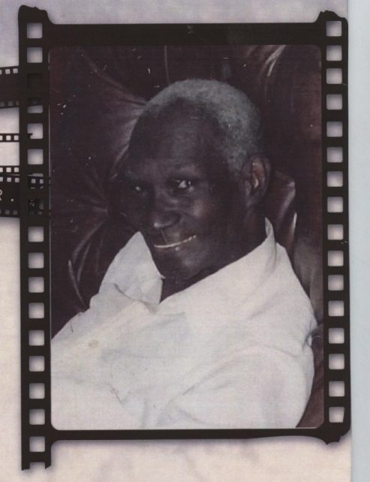
September 26th:
1918:
Basil Cyprian Ottley was born on St. Thomas. He operated Ottley’s Photo Studio for about 55 years of continuous operation. He is credited for using his skill to enable the Photo News, “An Independent Truth Paper For All the People”, to be the first Virgin Islands newspaper to be able to use local pictures on a daily basis.
Text & Picture: Funeral Booklet

Slide 32
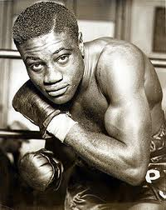
September 27th:
1881:
The Sydney Morning Herald reported Crucian born Peter Jackson, a heavy weight champion, fought Tom Lees from Australia. Known as Professor Jackson during his boxing career, the fight rather than an action-filled fight as expected, little blows were changed.
Text: Profiles of Outstanding Virgin Islanders, Ruth Moolenaar, Third Edition pg.114
Picture: http://boxrec.com/media/index.php/Young_Peter_Jackson_(LA)

Slide 33
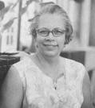
September 28th:
1911:
Enid Marie Baa, a regionally, nationally, and internationally recognized librarian, historian, cataloging specialist, John Hay Whitney Fellow, and Caribbeanist, was born on St. Thomas.
Text: Profiles of Outstanding Virgin Islanders, Ruth Moolenaar, Page 7
Picture: http://fostpl.org/main/?page_id=6

Slide 34
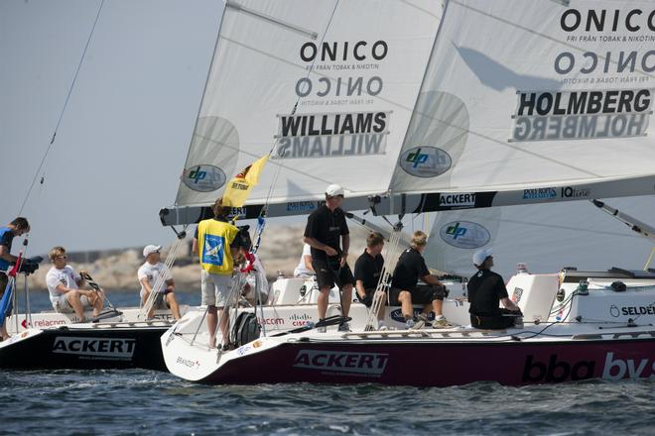
September 29th:
1988; Act #1368 was passed to honor and commend Peter Williams Holmberg for his accomplishments in the field of yachting. He was the first member of the USVI Olympic team to win an Olympic Medal.
Text: Legislative Archives
Picture: http://www.carlosmatchrace.com/skippers.php

Slide 35
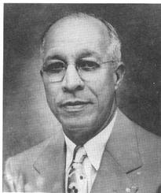
September 30th:
1881:
Claude O. Markoe was born on St. Croix. He is recognized as an outstanding educator who devoted his lifetime to education on St. Croix, where a public school is named in his honor.
Text: Profiles of Outstanding Virgin Islanders, Ruth Moolenaar, Page 146
Picture: http://www.stx.k12.vi/profiles/markoeco.htm

Slide 36
To receive monthly complimentary electronic historical cultural calendar, kindly contact …..
Division of Virgin Islands Cultural Education
ST. THOMAS / ST. JOHN
Mailing Address: 1834 Kongens Gade, STT, VI 00802
Physical Address: J. Antonio Jarvis Annex, STT, VI 00802
Telephone Number: 340-774-0100 x: 2804, 7032, 2806, or 2809
Fax Number: 340-777-4342
Email Addresses: yohance.Henley@vide.vi, mmartin@vide.vi or vbryson@vide.vi
ST. CROIX
2133 Hospital Street, C’sted, STX, VI 00822
Telephone Number: 340-773-1095
Fax Number: 340-773-4476

