Slide 1
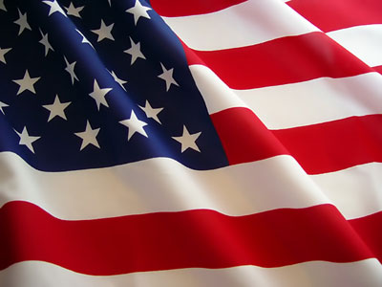
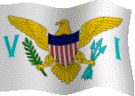
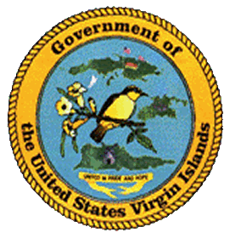


March Holidays Celebration Recognition
in the United States Virgin Islands
March:
Transfer Day … Friday, March 31st
Holidays observed by the United States Virgin Islands
strengthen an important process in the development of the territory.
Compliments of:
Virgin Islands Department of Education
Division of Virgin Islands Cultural Education
Building Our Future Through
Education, History and Culture!

Slide 2
Transfer Day
Transfer Day, which is honored on March 31, is a local holiday celebrating the transfer of the Danish West India Islands from Denmark to the United States of America. This year marks 99 years ago on March 31, 1917 when the Danish West India Islands were formally sold for twenty-five million dollars to the United States and became the United States Virgin Islands simultaneously on all three islands (St. Croix, St. John, and St. Thomas) at 4:00pm.
The US’ interest in the islands dates back as early as the Civil War, because of a need for a Caribbean Naval base. Although they were mostly interested in St. Thomas, the Danish wanted all three islands sold. So conversations to acquire them started in the mid-1860’s and in 1867 Denmark agreed to sell St. Thomas and St. John for seven and a half million dollars in gold, however it never matured due to a hurricane, an earthquake, a tsunami, and a fire that hit the islands the following year.
With an continued interest in these beautiful Virgin Islands, the purchase was finally completed in 1917. The residents were given ten years to either keep their Danish citizenship or become an American citizen after the purchase. Rather than becoming American citizens, the majority headed to Denmark. However they missed the islands’ beautiful tropical weather, and the West Indian foods, music, fruit trees and plants.
To re-enact the initial ceremony, there are special annual ceremonies on all three (3) islands. During such ceremonies the Danish flag is lowered and the US flag is raised symbolically as in 1917. Participants include government officials, community members, and local schools, as well as community groups such as the V.I. Humanities Council, St. Croix Friends of Denmark Society, the St. Croix Landmarks Society, Inc., and visitors to include the Danish West Indian Society.
Although the Virgin Islands are no longer a possession of Denmark, the islands maintain a warm relationship with the Danish people. The Danish cemeteries, the forts, street names, and the ruins of the former sugar plantations bear testimony to a rich Danish past.

Slide 3
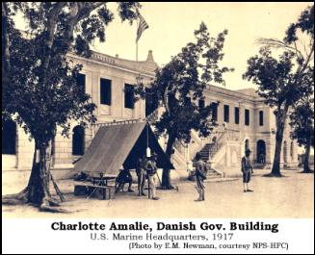
Happy Transfer Day!
Suggested Classroom and Family Activities:
Participate and/or attend a Transfer Day parade
Research the history of the Transfer Day holiday and with creativity share what you have learn with someone
Attend special ceremony commemorating the Transfer Day holiday
Visit the March 31, 1917 Transfer Day site on at least one of the three islands
Interview and/or read about someone who experienced the Transfer Day and/or who lived under both the Danish and American flags
Courtesy of
Text: http://en.wikipedia.org/wiki/Transfer_Day; http://voices.yahoo.com/observance-transfer-day-virgin-islands-5765624.html; http://www.dkconsulateusvi.com/transfer/transfer.html; http://virginislandsdailynews.com/news/v-i-marking-transfer-day-with-array-of-events-1.1293384;
Pictures: http://stjohnhistoricalsociety.org/vol-vi-no-5-march-2005-acquisition-of-the-danish-west-indies-by-the-united-states-by-bruce-schoonover/;

Slide 4
To receive monthly complimentary electronic holidays’ celebration recognition, kindly contact …..
Virgin Islands Department of Education
Division of Virgin Islands Cultural Education
ST. THOMAS / ST. JOHN
Mailing Address: 1834 Kongens Gade, STT, VI 00802
Physical Address: J. Antonio Jarvis Annex, STT, VI 00802
Telephone Number: 340-774-0100 x: 2804, 8043, 2806, 2808, or 2809
Fax Number: 340-777-4342
Email Addresses: yohance.henley@vide.vi, maria.martin@vide.vi, or valricabryson@vide.vi
Building Our Future Through
Education, History and Culture!

