Slide 1






MARCH 2017
HISTORICAL CULTURAL CALENDAR
COMPLIMENTS OF:
VIRGIN ISLANDS
DEPARTMENT OF EDUCATION
DIVISION OF
VIRGIN ISLANDS CULTURAL EDUCATION
Building Our Future Through
Education, History and Culture!

Slide 2
*** SPECIAL TRIBUTE ***
TO THE VARIOUS ENTERTAINERS THAT REPRESENT OUR VIRGIN ISLANDS INTERNATIONALLY.

Slide 3

Eron “DJ Avalanche” Brown

Slide 4
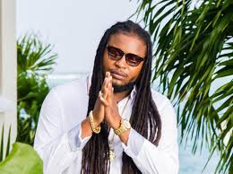
Delyno “Pressure Busspipe” Brown

Slide 5
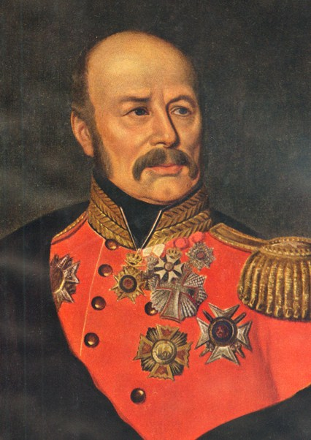
March 1st :
1774; Christian von Schiveder became Governor General of the Danish West Indies.
Courtesy of
Text: Manuscript of Charles Wesley Turnbull, Ph.D.

Slide 6
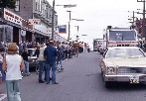
March 2nd:
1971; Approximately 500-700 persons led by Juan Centeno March on Government House, Christiansted, St. Croix to draw attention to the kidnapping a d murder of an 8 year old Hispanic girl and of the violent crime sweeping the islands. The crowd demanded a safer and cleaner St. Croix.
Courtesy of
Text: Manuscript of Charles Wesley Turnbull, Ph.D.

Slide 7
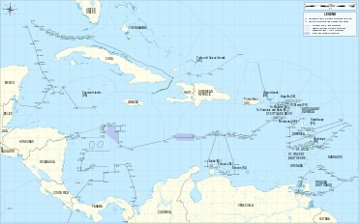
March 3rd:
1971; The Virgin Islands Daily News reported that cables were sent to Virgin Islands Senate President, John L. Maduro by the Virgin Islands. A malgated workmen Union and the United Alien Association demanding an investigation into treatment of aliens from neighboring West Indian islands who were being rounded up and deported.
Courtesy of
Text: Manuscript of Charles Wesley Turnbull, Ph.D.

Slide 8
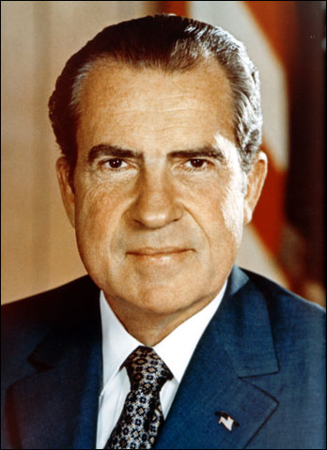
March 4th :
1969: President Richard M. Nixon nominated Virgin Islands Comptroller as governor Bowe, however, declined post on grounds of ill health.
Courtesy of
Text: Manuscript of Charles Wesley Turnbull, Ph.D.

Slide 9
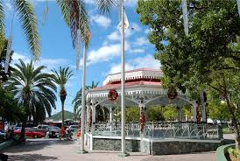
March 5th :
1903: An industrial and agricultural exhibition opened at Emancipation Garden and the Apollo Theater in Charlotte Amalie, St. Thomas.
Courtesy of
Text Manuscript of Charles Wesley Turnbull, Ph.D.

Slide 10
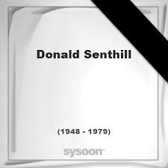
March 6th :
1948: Donald O. Senthill, educator, humanitarian, athlete, and noted basketball coach, was born in Frederiksted, St. Croix
Courtesy of
Text: Manuscript of Charles Wesley Turnbull, Ph.D.

Slide 11
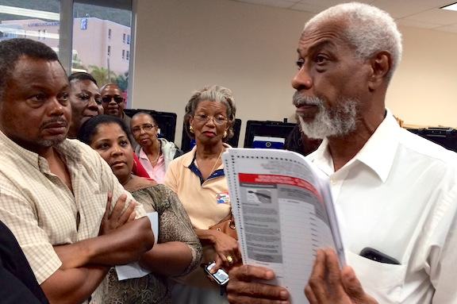
March 7th :
1953; Arturo Watlington, Jr, who has served in the 19th and 20th Legislatures of the USVI from St. Thomas / St. John District, political and civic leader, attorney-at-law, was born in St. Thomas.
Courtesy of
Text: Text: Black Facts from the Facts Man (January 1 – June 10), Wayne “Facts Man” Adams

Slide 12
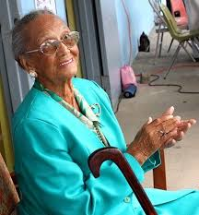
March 8th :
1963; Act #954 was approved mandating that two school buildings in St. Thomas named in honor of the Peace Corps of the United States, namely at Nisky Elementary (now Ulla F. Muller) and the grounds of the James Madison (now Edith Williams) Schools, be known as the Peace Corps Building.
Courtesy of
Source: www.webpac.uvi.edu/imls/pi-uvi/historical_notes_on-schoolds.pdf

Slide 13
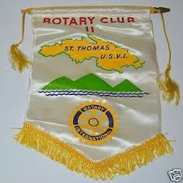
March 9th :
1991 Captain Constantino Coulianos, a founder father of Rotary in the Virgin Islands, merchant seaman, author, businessman and philanthropist died in St. Thomas hospital.
Courtesy of
Source: March 11, 1991 Daily News page 3

Slide 14
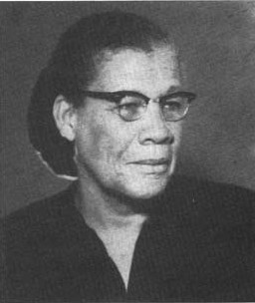
March 10th :
1965:
The bill was approved to designate the home for elderly persons to be constructed in St. Thomas as the ‘Lucinda Millin Home’ through sponsorship of Bill #2436. It recognized Mrs. Lucinda A. Millin as an educator and the first elected female to the VI Legislature.
Courtesy of
Text: Profiles of Outstanding Virgin Islanders Third Edition, Ruth Moolenaar, page 159
Picture: http://webpac.uvi.edu/imls/pi_uvi/profiles1992/Educators/Millin_L/index.shtml

Slide 15
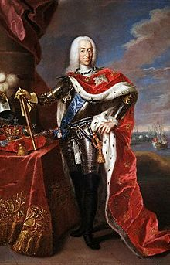
March 11th :
1671; King Christian VI grants charter to Danish West India Company to colonize St. Thomas and any other uninhabited islands. The charter also allowed for the later colonization of St. John.
Courtesy of
Text: A Virgin Islands Guide 1665-2005

Slide 16

March 12th :
1975; Virdin C. Brown, who served in the USVI’s 9th and 10th Legislatures from the St. Thomas/ St. John District, became the Commissioner of the USVI’s Department of Conservation and Cultural Affairs
Courtesy of
Text: Black Facts from the Facts Man (January 1 – June 10), Wayne “Facts Man” Adams

Slide 17
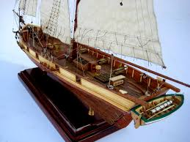
March 13th :
1801; The Danish Warship, ‘The Vigilant”, which sailed to, between, and from the Danish West Indies for more than a hundred years was victorious in a naval engagement with two English frigates.
Courtesy of
Text: Manuscript of Charles Wesley Turnbull, Ph.D.

Slide 18
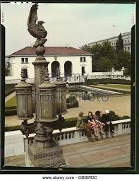
March 14th :
1957, The works of 7 Virgin Islands artists were exhibited at the Pan American Union art exhibition in Washington, D.C. The artists were Aline Kean, Alfred Lockhart, Enid Kimmel, Ruth Gregory, Albert Daniel, Sasha Manson and Marie Moore.
Courtesy of
Text: (Daily News March 14, 1977 page 20)

Slide 19
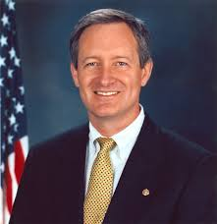
March 15th :
2006; The Federal Elections Commission reported that US Senator Mike Crap Republican of Idaho received more than twice as much money in donations in 2005 from people in the Virgin Islands than from those in his home state.
Courtesy of
Text: Manuscript of Charles Wesley Turnbull, Ph.D.

Slide 20

March 16th :
1962; This year marked the 40th anniversary of the University of the Virgin Islands’ founding.
Courtesy of
Text: University of the Virgin Islands UVI Magazine 40th Anniversary, 2002, Volume 6, page 37

Slide 21
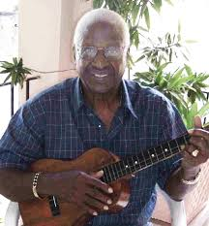
March 17th :
2009; Elmo Delano Roebuck, former VI Senate President and Commissioner of Housing and Community Renewal, political and civic leader and activist, educator, folklorist and cultural bearer died in St. Thomas at age 74.
Courtesy of
Text: Manuscript of Charles Wesley Turnbull, Ph.D.

Slide 22
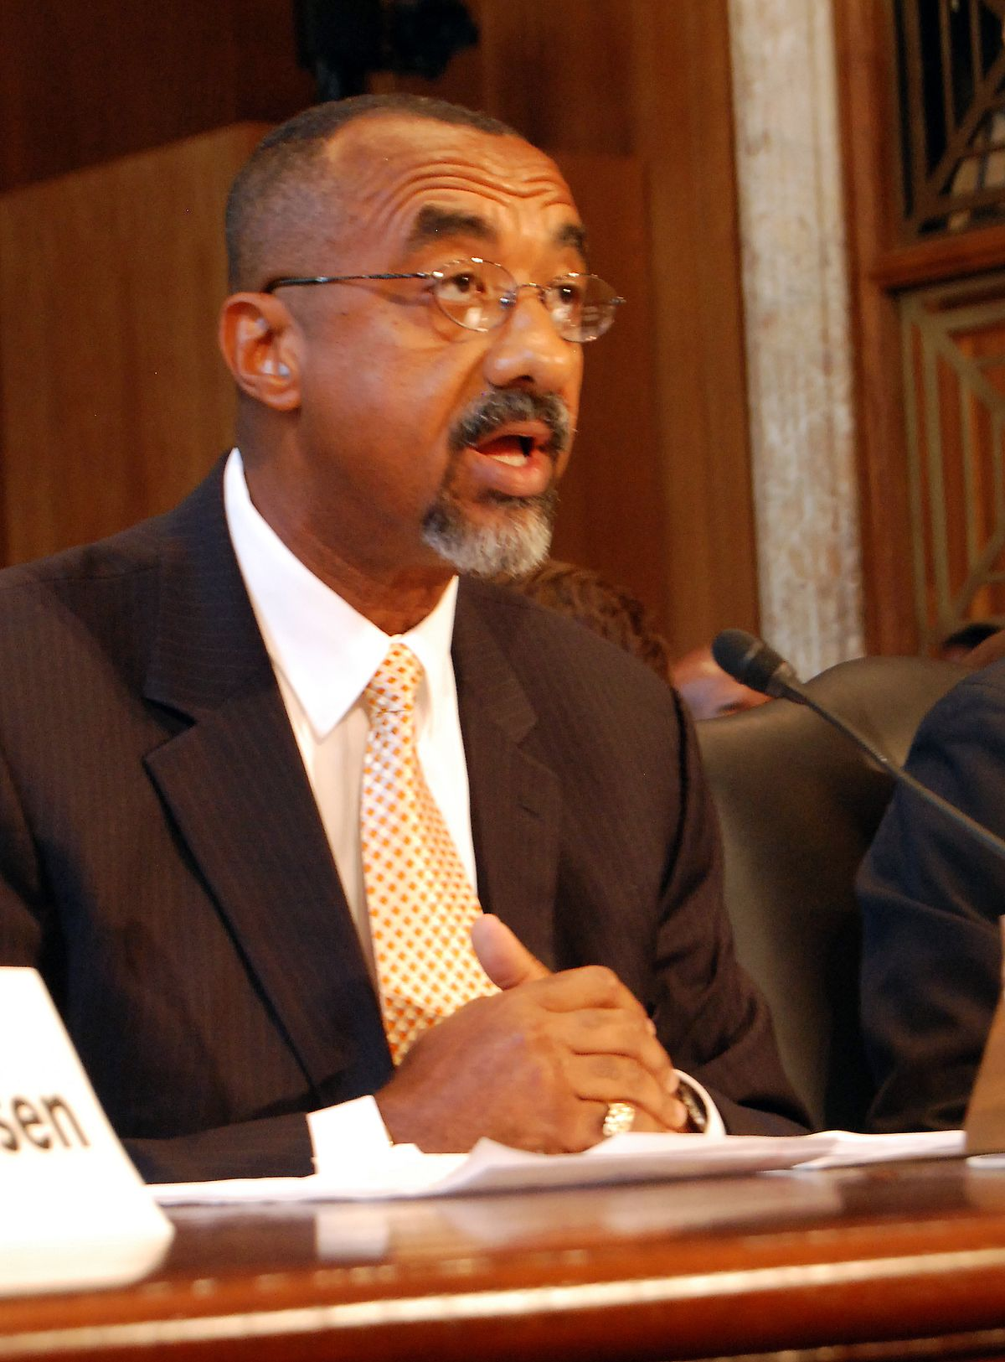
March 18th :
1953; Gerard Luz A. James II, Lieutenant Governor (1999-2003), legislator, political and civic leader, activist, and business man, was born.
Courtesy of
Text: Manuscript of Charles Wesley Turnbull, Ph.D.

Slide 23
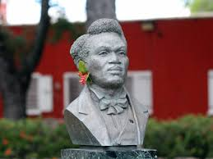
March 19th :
1820:
Moses ‘Buddhoe’ Gottlieb was born enslaved at Estate LaGrange in St. Croix. He was the principal leader of the rebellion that led to the emancipation of the enslaved Africans in the Danish West Indies on July 3, 1948.
Courtesy of
Text: Manuscript of Charles Wesley Turnbull, Ph.D.

Slide 24
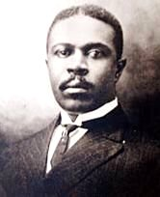
March 20th :
1922:
D. Hamilton Jackson criticized St. Thomas Police Court Judge Payne in an editorial in St. Croix’s Labor Union’s paper, The St. Croix Herald. For this he was subsequently found guilty of contempt of court and sentenced to six days in jail.
Courtesy of
Text: Manuscript of Charles Wesley Turnbull, Ph.D.

Slide 25
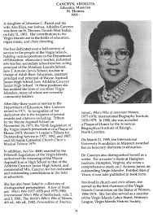
March 21st :
1983; The USVI’s 15th Legislature passed legislation that would rename a St. Thomas junior high school in honor of the educator, Addelita Cancryn
Courtesy of
Text: Black Facts from the Facts Man (January 1 – June 10), Wayne “Facts Man” Adams

Slide 26

March 22nd :
1767; Christian G.A. Oldendorp, noted Moravian leader and advocate and early historian of the Danish West Indies arrived in St. Croix to record the progress and activities of the Moravian missions since their inception and to chronicle the history of the Danish colony to date.
Courtesy of
Text: Manuscript of Charles Wesley Turnbull, Ph.D.

Slide 27

March 23rd :
1967, the British Virgin Islands Constitutional Order was issued from London establishing the ministerial form of Government there. Many of their citizens living in the USVI would return home to vote annually hence.
Courtesy of
Text: St. Croix Avis April 9, 1973 page 3

Slide 28
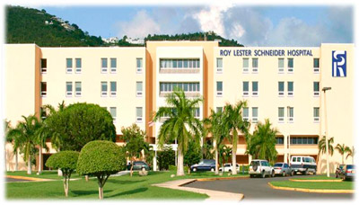
March 24th :
1996:
The St. Thomas Hospital and Community Health Center was renamed the Roy Lester Schneider Hospital and Community Health Center.
Courtesy of
Text: Manuscript of Charles Wesley Turnbull, Ph.D.

Slide 29
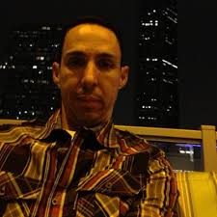
March 25th :
2012; Apolinar Acevedo Jr. (16 year old Central High School student) won his third straight race on the U.S. Virgin Islands Cycling Federation’s St. Croix circuit. He won the 48-mile race in a time of 2 hours, 27 minutes and 30 seconds. He crossed the finish line 1 second in front of his father.
Courtesy of
Text: The Virgin Islands Daily News, March 28, 2012, page 38

Slide 30

March 26th :
1718, Governor Erik Bredal took possession of St. John with 20 planters, 5 soldiers and 16 slaves at Coral Bay.
Courtesy of
Text: History of the Virgin Islands Isaac Dookham page 56

Slide 31
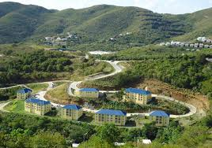
March 27th :
2012; The ribbon cutting ceremony was held for the St. Thomas’ newest affordable housing community – Grandview Apartments, an Estate Donoe development. It was held at the site to admire the first phase of the project – 54 affordable housing units.
Courtesy of
Text: The Virgin Islands Daily News, March 30, 2013, page 6

Slide 32
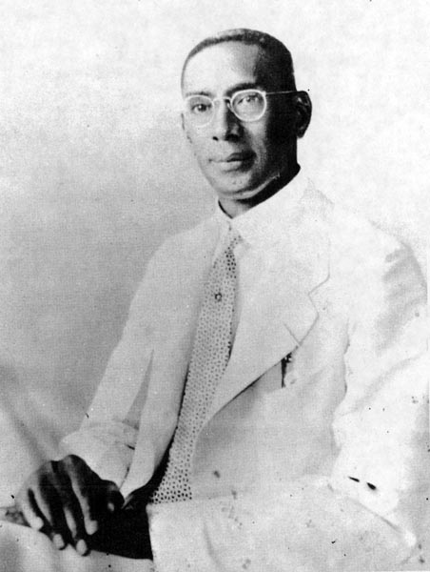
March 28th :
1952:
David C. Canegata became the first native Virgin Islander to be appointed Administrator for the island of St. Croix.
Courtesy of
Text: Manuscript of Charles Wesley Turnbull, Ph.D.
Picture: http://thehousethatfreedombuilt.blogspot.com/2013/07/interview-diane-canegata-oreilly.html

Slide 33
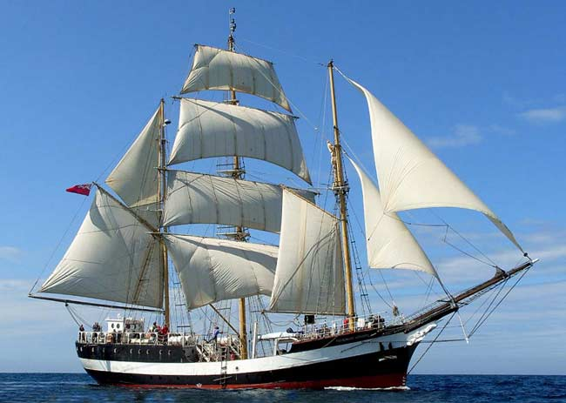
March 29th :
1673; The sailing vessel Pelican arrived in St. Thomas with 60 colonists. Seventy died en route and fifty three died soon after arrival.
Courtesy of
Text: Manuscript of Charles Wesley Turnbull, Ph.D.

Slide 34
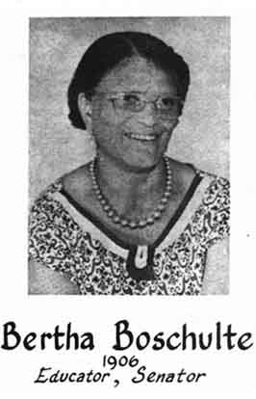
March 30th :
1906:
Bertha C. Boschulte was born in St. Thomas. She was a legislator, teacher, principal, community activist, member of numerous boards and commissions, and the BPW Woman of the Year. The Bertha C. Boschulte Middle School is named in her honor.
Courtesy of
Text: Profiles of Outstanding Virgin Islanders, Ruth Moolenaar, page 3
Picture: http://webpac.uvi.edu/imls/pi_uvi/profiles1976/Educators/Boschulte_B/pic.shtml

Slide 35
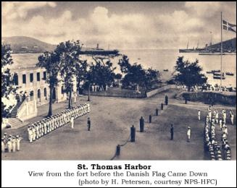
March 31st :
1917; The Danish West Indies were formally transferred from Denmark to the United States and were officially named the Virgin Islands of the United States of America.
Courtesy of
Text: Manuscript of Charles Wesley Turnbull, Ph.D.

Slide 36

Theron and Timothy Thomas
“Rock City”

Slide 37
To receive complimentary monthly electronic historical cultural calendar, kindly contact …..
Virgin Islands Department of Education
Division of Virgin Islands Cultural Education
ST. THOMAS / ST. JOHN
Mailing Address: 1834 Kongens Gade, STT, VI 00802
Physical Address: J. Antonio Jarvis Annex, STT, VI 00802
Telephone Number: 340-774-0100 x: 2804, 2806, 2808, or 2809
Fax Number: 340-777-4342
Email Addresses: yohancehenley@vide.vi, mmartin@doe.vi
Building Our Future Through
Education, History and Culture!

