Slide 1
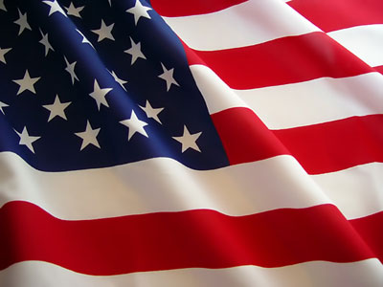

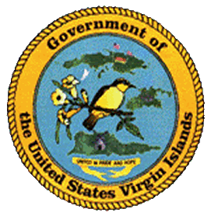


January Holidays / Celebrations Recognition
in the United States Virgin Islands
January:
New Year’s Day … Friday, January 1st
Kwanzaa … Saturday, December 26th – Friday, January 1st
St. Croix Crucian Christmas Carnival … December -January
Three Kings Day … Wednesday, January 6th
Martin Luther King Jr. Day … Monday, January 20th
Holidays observed by the United States Virgin Islands
strengthen an important process in the development of the territory.
Compliments of:
Virgin Islands Department of Education
Division of Virgin Islands Cultural Education
Building Our Future Through
Education, History and Culture!

Slide 2
New Year’s Day
The first day of each year is celebrated as New Year’s Day and it is a federal holiday.
Research revealed the first recorded new year was celebrated in 153 B.C. in Rome on January 1st. It expounds that the month of January did not exist until around 700 B.C. when February was added by Numa Pontilius, the second king of Rome. When Julius Caesar introduced a new solar-based calendar in 46 B.C., the Julian calendar decreed that the new year would occur with January 1. Therefore, in the Roman world, January 1 was consistently observed as the start of the new year. Several changes were made from time to time, however in 1582 the Gregorian calendar reform restored January 1st as the New Year’s Day. To date, this practice continues.
Like the Christmas celebration, in the United States Virgin Islands, New Year’s Day is an opportunity for families, friends, and community members to attend church. On the climax of the Old Years Day just before sunset and or before midnight, special church services and mass are held at different churches. These services are noted as one of the biggest church gatherings for the year. Traditionally, at midnight the new year is welcomed with fireworks in the harbors.
It is customary like Christmas Day that large meals are prepared as families and friends gather together during the day and evening hours in celebration. The meals consist of the best foods and desserts, such as sweetbread, tarts, ham, turkey, cranberry, guava berry liquor, and other local dishes. In the United States Virgin Islands, the New Year’s Day is truly a time for our family and community to come in unity and enjoy the fellowship of one another.

Slide 3
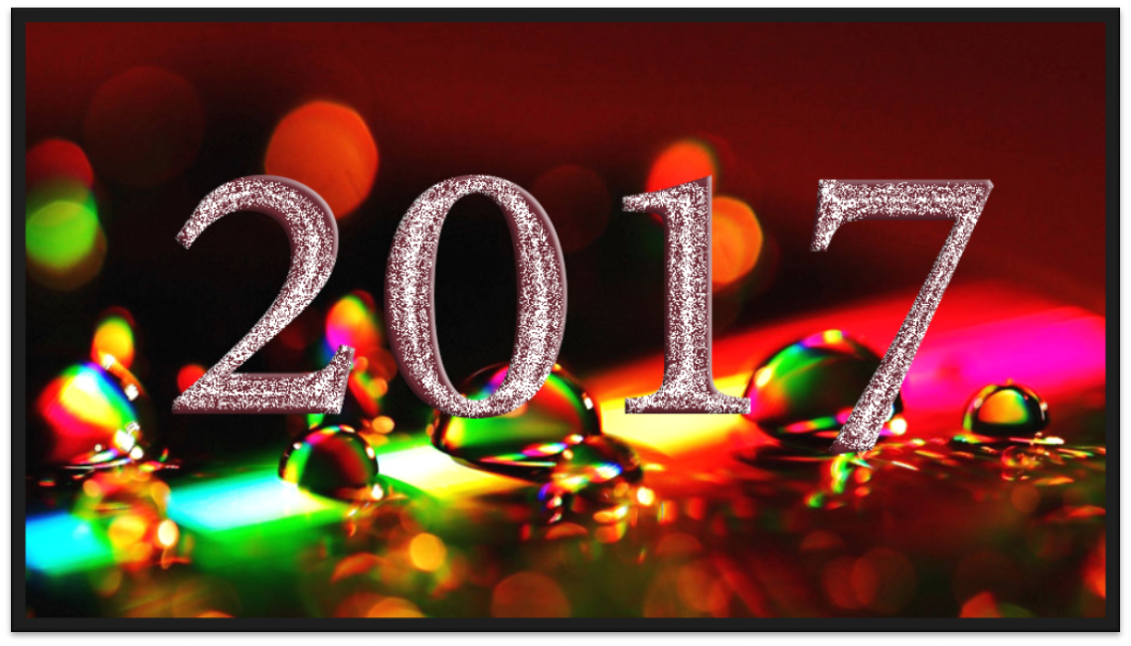
Suggested Family and Classroom Activities:
Plan and participate in a New Years Day meal with family and friends
Attend a church service
Invite a friend to celebrate the day with your family.
Courtesy of
Text: A History of the New Year — Infoplease.com http://www.infoplease.com/spot/newyearhistory.html#ixzz2E1QPF3UU
Pictures: http://www.happynewyearwishes.co.in/

Slide 4
Kwanzaa
The Kwanzaa Celebration is observed from December 26 through January 1. It was created by Dr. Maulana Karenga and first celebrated in 1966 – 67. Held in the United States and Western African Diaspora in other nations the week-long celebration honors African heritage in African-American culture and culminates in a feast and gift-giving. It has seven core principles (Nguzo Saba, originally Nguzu Saba – the seven principles of African Heritage).
In the early years of Kwanzaa, Dr. Karenga intended it to be an alternate for Christmas. However, this posture was later changed, so Christians would not be alienated. He later stated in the 1997 Kwanzaa: A Celebration of Family, Community, and Culture, "Kwanzaa was not created to give people an alternative to their own religion or religious holiday.” Today many African Americans celebrate Kwanzaa in addition to observing Christmas.
What Karenga said "is a communitarian African philosophy," consist of what he called "the best of African thought and practice in constant exchange with the world." These seven principles comprise Kawaida, a Swahili term for tradition and reason. Each day of Kwanzaa is dedicated to one of the principles below:
The symbols of Kwanzaa include a decorative mat on where other symbols are placed, corn and other crops a candle holder with seven candles is called a kinara, a communal cup for pouring libations, gifts, a poster of the seven principles, and a black, red, and green flag. The symbols were designed to convey the seven principles.
On the first day of Kwanzaa the black candle is lit, representing the first principle of Kwanzaa – Umoja (oo-MOH-jah): Unity.
On the second day the black candle is again lit, as well as the farthest red candle on the left. This represents the 2nd principle of Kwanzaa – Kujichagulia (koo-jee-chah-goo-LEE-ah): Self-Determination.
On the third day the black candle is lit, then the farthest left red, and then the farthest right green candle. This represents the 3rd principle of Kwanzaa – Ujima (oo-JEE-mah): Collective work and responsibility.
On the fourth day the black candle is lit, then the farthest left red, then the farthest right green and then the next red candle on the left. This represents the 4th principle of Kwanzaa – Ujamaa (oo-jah-MAH): Collective economics.
On the fifth day the black candle is lit, then the farthest left red, the farthest right green, the next red and then the next green candle. This represents the 5th principle of Kwanzaa – Nia (NEE-ah): Purpose.
On the sixth day the black candle is lit, then the farthest left red, the farthest right green, the next red, the next green and then the final red candle. This represents the 6th principle of Kwanzaa – Kuumba (koo-OOM-bah): Creativity.
On the seventh day the black candle is lit, then the farthest left red, the farthest right green, the next red candle, the next green, the final red and then the final green candle. Now all seven candles are lit. This represents the 7th principle of Kwanzaa – Imani (ee-MAH-nee): Faith.

Slide 5
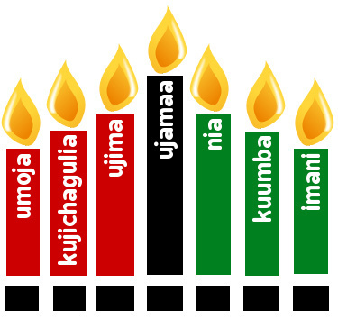
Suggested Family and Classroom Activities:
Research the history of Kwanzaa
Interview a participant of their experience while participating in Kwanzaa
Experience participating in the celebration of Kwanzaa
Courtesy of
Text: http://en.wikipedia.org/wiki/Kwanzaa; http://ourheritagemagazine.com/our-heritage-magazine-online/kwanzaa/
Picture: http://ourheritagemagazine.com/our-heritage-magazine-online/kwanzaa/

Slide 6
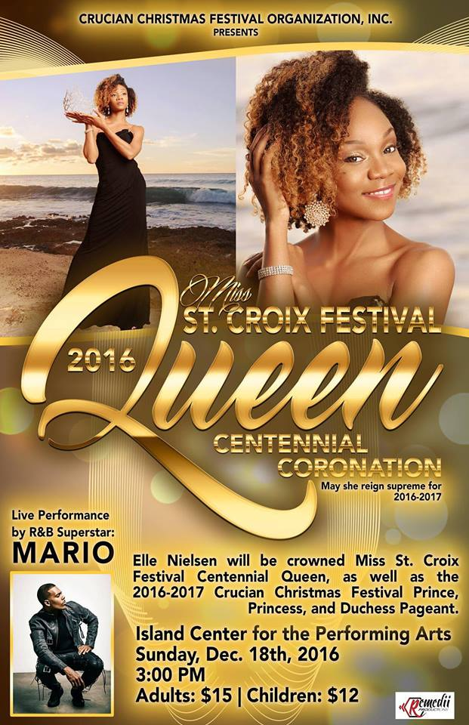
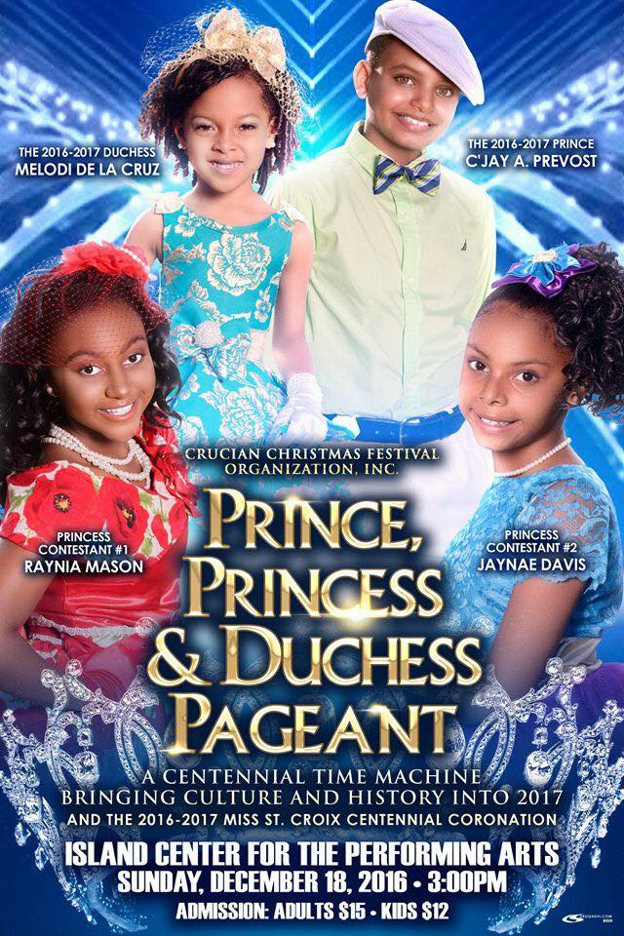
St. Croix Crucian Christmas Carnival
It’s that time of the year again! The St. Croix Crucian Christmas Carnival will be celebrating its 64th Centenial Carnival Celebration for 2016- 2017.
Between Christmas and New Year, there will be activities in both Christiansted and Frederiksted including calypso shows, Latin music venues, food fairs showcasing local crafts, food, and drinks, horse races, parades, royalty pageants, and the night entertainment of local bands and musicians at the village. The St. Croix Crucian Christmas Carnival is one of the biggest annual events in the Virgin Islands; it is more than a large party; it is an exposition of culture and tradition.
QUEEN CONTESTANTS
PRINCE AND PRINCESS CONTESTANTS

Slide 7
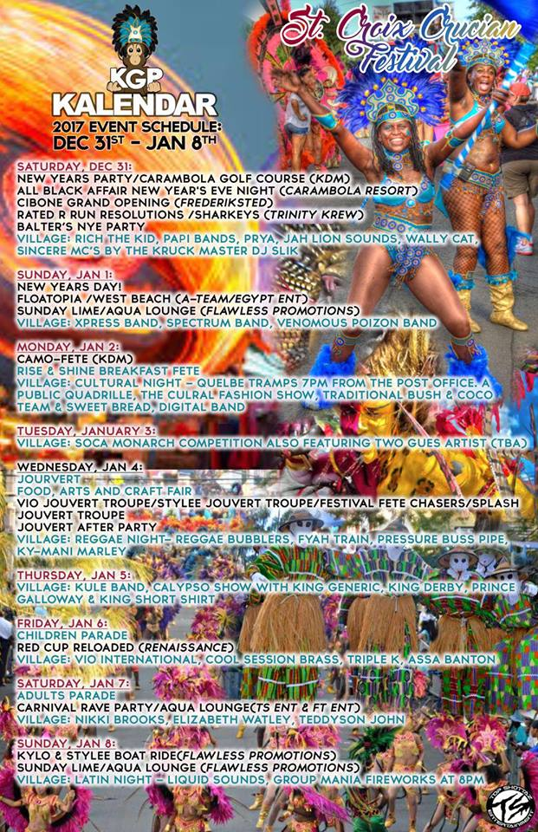
Suggested Family and Classroom Activities:
Research the history and origin of the Crucian Christmas Carnival
Engage in a carnival event and creatively share your experience
Speak to a former participant about his/her experience and share their experience with someone
Courtesy of
Text: https://www.facebook.com/search/top/?q=st.%20croix%20carnival%20schedule
Images: https://www.facebook.com/search/top/?q=st.%20croix%20carnival%20schedule

Slide 8
Three Kings Day
Three Kings Day is a local holiday celebrated on January 6th or the Epiphany. Also known as “El Día de los Reyes Magos”, it is the day believed that The Three Wise Men delivered gifts of frankincense, myrrh and gold to Baby Jesus in the manager in Bethlehem.
It is quite a festive celebration, especially among the Spanish communities on the mainland. Christmas trees are still up for the final celebration of the holiday season. On the evening of January 5th, the children leave an empty shoe outside or put a box of grass, corn, or other camel food under their beds and anxiously wake up to some small token. The bakeries bake Rosca de Reyes, a doughnut-shaped pastry with a hidden plastic Baby Jesus inside. Surrounded by family, it is eaten. To add to the celebration there are parades with live camels and children with plastic crowns marching down major streets with proud parents looking and cheering them on.
In the U.S. Virgin Islands, it is a festive cultural celebration time, especially on the island of St. Croix. This is the day when the St. Croix Crucian Christmas Carnival climaxes after their month long of fun-filled traditional and cultural activities.
Some community members pack the beach with family and friends for a party of barbecue and music.
Many Christians use this time to solemnly reflect on the spiritual perception of the end of the Christmas Season, which celebrates the birth of Baby Jesus.

Slide 9
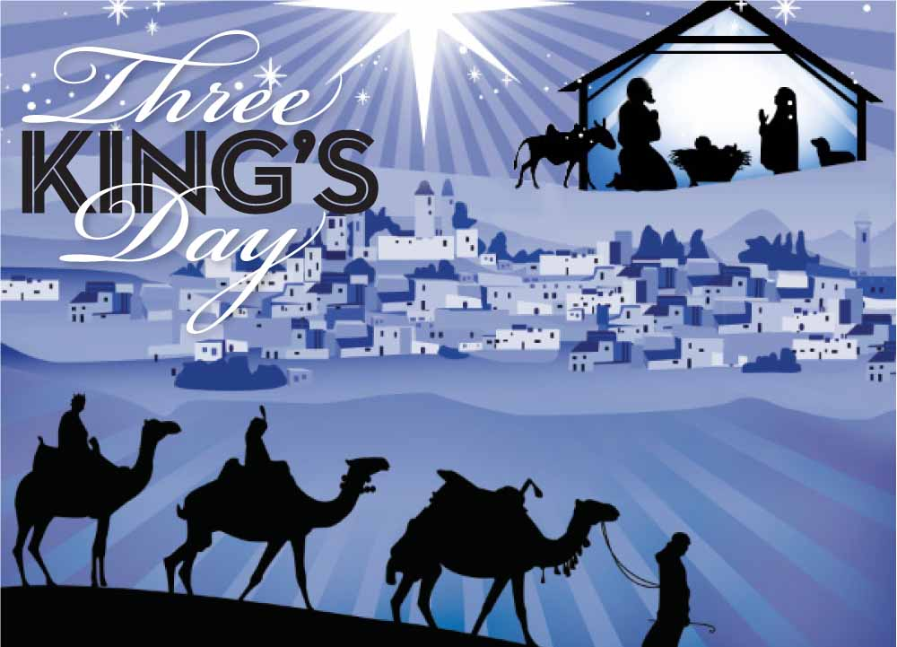
Suggested Family and Classroom Activities:
Participate in the Latino celebration
Research the origin of Three Kings Day and share what you learn
Learn how to make a Rosca de Reyes
Courtesy of
Text: http://latino.foxnews.com/latino/lifestyle/2011/01/06/bothers-kings-day/; http://three-kings-day.123holiday.net/;
Picture: http://mblog.macys.com/experience-the-magic-of-three-kings-day-at-macys-2/

Slide 10
Martin Luther King Jr. Day
Martin Luther King, Jr. Day is celebrated on the third Monday in January. It is a federal holiday.
The US Virgin Islands was the forerunner in celebrating Dr. Martin Luther King, Jr. Day. It was a legal US Virgin Islands holiday as far as January 1971. It celebrated his birthday and showed appreciation for the work of a famous man whose efforts were dedicated towards peace and brotherhood among all men. It wasn’t until November 2, 1983 that it was signed into law by President Ronald Reagan and first observed in 1986 on the mainland.
This holiday celebrates the magnificent life and contribution of Dr. Martin Luther King Jr., who was born on January 15, 1929 to Reverend Martin Luther King Sr. and Alberta Williams King. He grew up in Atlanta, Georgia and attended Booker T. Washington High School where he skipped both 9th and 12th grade. As a 15 year old, he attended Morehouse College and graduated with a Bachelor of Arts degree in Sociology. He later attended Crozer Theological Seminary in Chester, PA and obtained his Doctorate in Systematic Theology from Boston University. In June 1953, he married the former Ms. Coretta Scott and he became a pastor at Dexter Avenue Baptist Church in Montgomery, Alabama at age 24. Dr. Martin Luther King, Jr. became the youngest recipient of the Nobel Peace prize in 1964 for his work in the civil rights movement and his strong desire to accomplish his goal of ending racial prejudice and segregation in the United States through non-violence.
There are elaborate celebrations on the mainland and the US Virgin Islands. In public, private, and parochial schools in both districts, there are special in-house programs of friendly competition of speeches, poems, plays, and songs. It is commemorated with parades and speeches showcasing his life. In addition, radio station host some of his favorite and famous speeches.

Slide 11
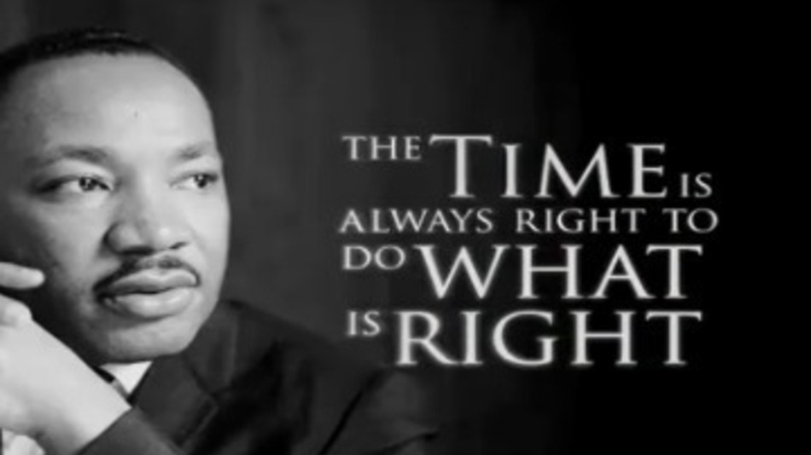
Suggested Family and Classroom Activities:
Research about Dr. Martin Luther King, Jr. and share what you learn
Practice the principles and philosophies of Dr. Martin Luther King, Jr.
Make a replica of his hometown
Interview individuals who lived during his era about their struggles and experiences
Participate in a Dr. Martin Luther King, Jr. parade
Visit the ceremonial site of Dr. Martin Luther King, Jr. site (his birthplace, tomb, church, etc.) in Atlanta, Georgia
Courtesy of
Text: http://www.messiah.edu/external_programs/agape/local_service/MLKAbout.html; A Teachers Guide to Holiday Observances in the VI; Legislature Archives
Pictures: https://sites.google.com/a/apps.edina.k12.mn.us/mr-sebek-s-3rd-grade-class/

Slide 12
To receive monthly complimentary electronic holidays celebrations recognition, kindly contact …..
Virgin Islands Department of Education
Division of Virgin Islands Cultural Education
ST. THOMAS / ST. JOHN
Mailing Address: 1834 Kongens Gade, STT, VI 00802
Physical Address: J. Antonio Jarvis Annex, STT, VI 00802
Telephone Number: 340-774-0100 x: 2804, 8043, 2806, 2808, or 2809
Fax Number: 340-777-4342
Email Addresses: Yohance.henley@vide.vi; mmartin@vide.vi; vbryson@vide.vi
Building Our Future Through
Education, History and Culture!

