Slide 1





JANUARY 2017
HISTORICAL CULTURAL CALENDAR
COMPLIMENTS OF:
VIRGIN ISLANDS
DEPARTMENT OF EDUCATION
DIVISION OF
VIRGIN ISLANDS CULTURAL EDUCATION
Building Our Future Through
Education, History and Culture!

Slide 2
SPECIAL TRIBUTE
HISTORICAL LANDMARKS
AND TOURIST ATTRACTIONS
OF THE
UNITED STATES VIRGIN ISLANDS

Slide 3
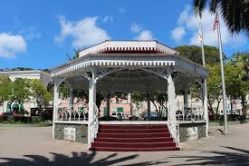
Emancipation Garden-STT
Courtesy of: Division of Virgin Islands Cultural Education

Slide 4
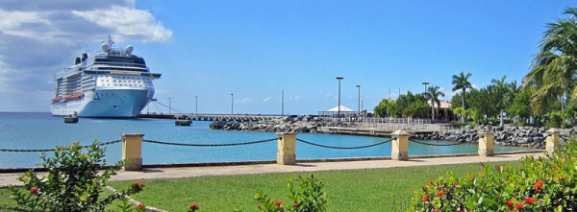
ANNE E. ABRAMMSON MARINE FACILITY
(FREDERIKSTED DOCK)-STX
Courtesy of: Division of Virgin Islands Cultural Education

Slide 5
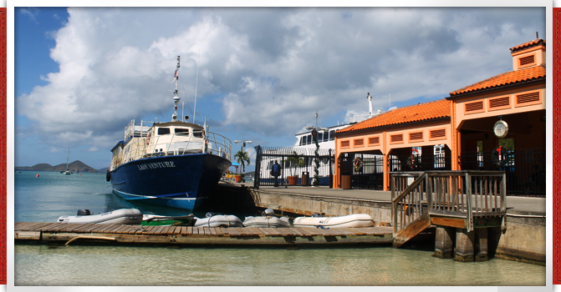
Cruz Bay Ferry Dock - STJ
Courtesy of: Division of Virgin Islands Cultural Education

Slide 6
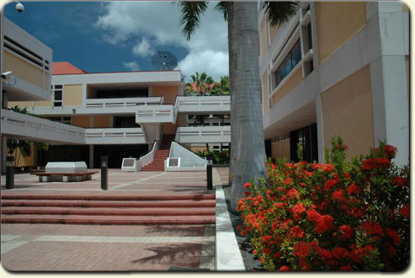
JANUARY 1ST
1977: The designation Municipal Court was replaced with the new title Territorial Court.
Courtesy of
Source: Daily News 1/4/1977 page 1

Slide 7
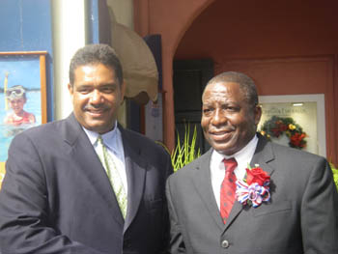
JANUARY 2ND
2007: Governor John DeJongh and Lieutenant Governor Gregory Francis take oaths of office and are sworn in.
Courtesy of
Source: Daily News 1/2/2007 page 1

Slide 8
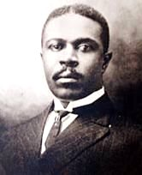
JANUARY 3RD
1851: The Danish Press Law was established. It was not applied to the DWI until 1915 through the efforts of D. Hamilton Jackson
Courtesy of
Source: Daily News 1/4/1977 page 10

Slide 9
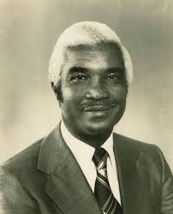
JANUARY 4TH
1978: Cyril E. King passed away on a Monday. He did not go gentle into that good night, he fought the ravage of an inoperable cancer until complications arose from its treatment ,
finally took him.
Courtesy of
Text: Thought Along the was, Ariel Melchior, Sr. page. 561

Slide 10
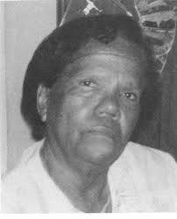
JANUARY 5TH
2009: A Cultural icon, educator and beloved matriarch to many, passed away on this day. Eulalie “Marlee” Rohlsen Rivera died at the
age of 100.
Courtesy of
Source: Daily News1/5/2009 page. 9

Slide 11
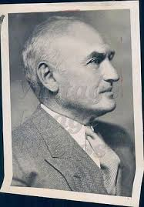
JANUARY 6TH
1841: President Roosevelt appointed Charles Harwood to replace
Lawrence Cramer
as Governor.
Courtesy of
Source: Daily News 1/6/1977 page 11

Slide 12
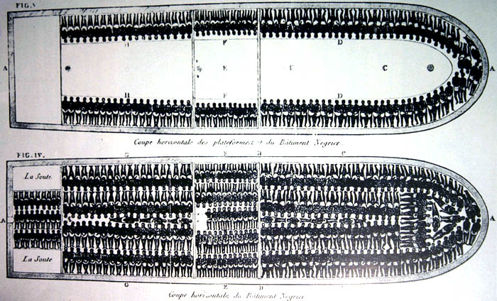
JANUARY 7TH
2003: On this day it was said by park services that 2 slave ship wrecks likely took place in Virgin Islands waters.
Courtesy of
Source: Daily News 1/7/2003 page. 6

Slide 13
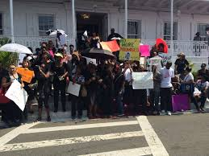
JANUARY 8TH
1976: A major teachers strike Territory-wide started and lasted five weeks, ending on February 15th of that year due to an injunction granted forcing teachers to return to work.
Courtesy of
Source: Daily News 1/4/1977 page. 1

Slide 14
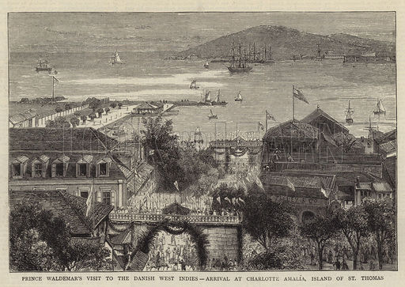
JANUARY 9TH
2009: The book “I Born Here” by Enrique F. “Rico” Coneiro that traces 200 plus years of the Coneiro family in St. Thomas was copyrighted through publisher Triple E. Enterprises.
Courtesy of
Text: I Born Here by Enrique Corneiro Publisher’s page

Slide 15
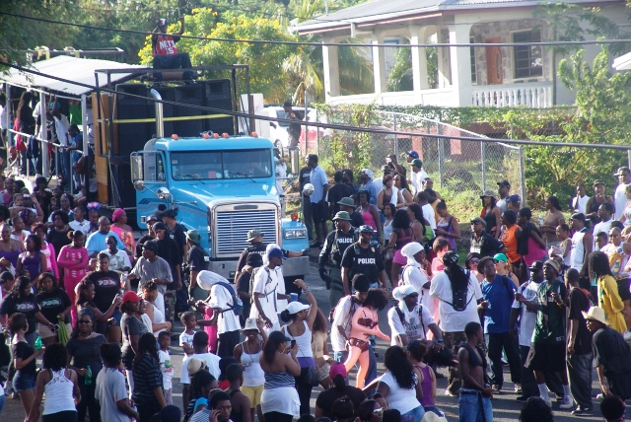
JANUARY 10TH
2005: The streets of Frederiksted were filled with high energy, bright colors and lots of local culture Saturday as more than 20,000 people converged on the town for the 52nd anniversary of the Crucian Christmas Festival Adult Parade.
Courtesy of
Source: Daily News 1/10/2005 page. 3

Slide 16
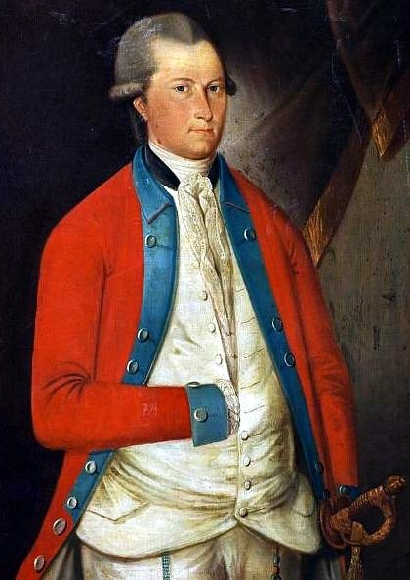
JANUARY 11TH
1801: St. Thomas Commandant Casimir von Scholten reported to the Burgher Council of the Island’s inability to withstand any attack due to militia mostly of Englishmen, unacceptable mortality rate among soldier’s, shortage of ammunitions and untrustworthy freedmen– especially
the French.
Courtesy of
Text: The Danish West Indies: Empire without Dominion 1671-1848 by N.A.T. Hall pages 18-20

Slide 17
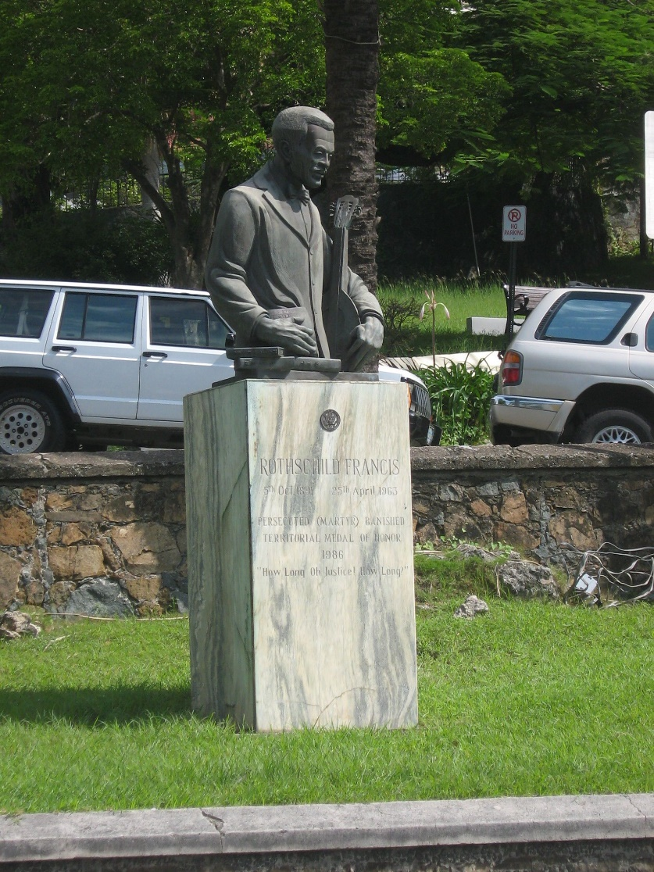
JANUARY 12TH
1925: Rothschild Francis was found guilty for libel for his December 27, 1924 editorial and sentenced to thirty days in prison. Circuit Judge Woolley of the Circuit Court reversed this conviction.
Courtesy of
Text: Rothschild Francis and Freedom of the Press USVI Islands, by William W. Boyer, page 17

Slide 18
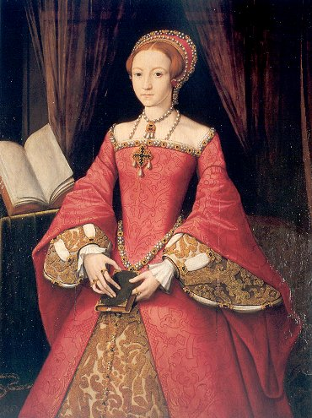
JANUARY 13TH
1559: The day Elizabeth I was crowned queen. During her reign, these islands would be named the Virgin Islands for the second time, and in her honor.
Courtesy of
Source: The Avis January 13, 2010 page 6

Slide 19
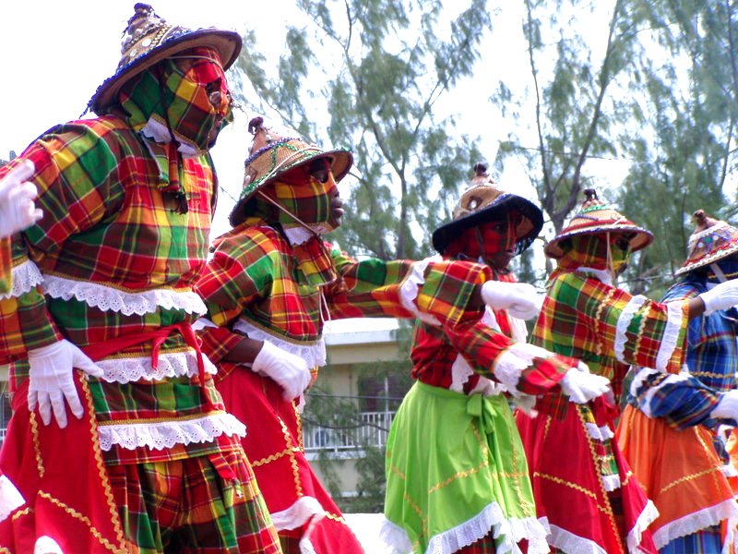
JANUARY 14TH
2009: The Ricardo Richards Elementary Mocko Jumbies won a newly revived award for their creative and accurate representation of local culture at the Crucian Christmas Festival’s
Children’s Parade.
Courtesy of
Source: Daily News 1/14/2009 page. 6

Slide 20
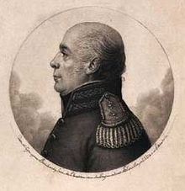
JANUARY 15TH
1816: Governor General Peter Oxholm upon the return of the Islands to Denmark issued a new placard of new regulations for Permits of Residence, Burgher Briefs and Free Briefs.
Courtesy of
Source: Daily News 1/15/1977 page. 7

Slide 21
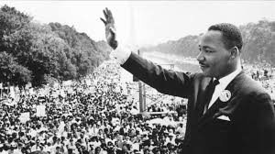
JANUARY 16TH
2010: The Daily News announced seven local high school students were honored for their exemplification of the teachings of the Rev. Martin Luther King Jr. at the Hebrew Congregation’s annual awards ceremony and evening Shabbat service at the St. Thomas Synagogue.
Courtesy of
Source: Daily News January 16, 2010 page. 1

Slide 22
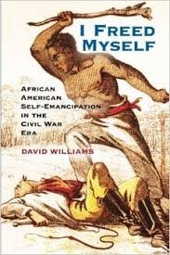
JANUARY 17TH
1998: A seminar held on St. Croix about “The Struggle for Self-Emancipation from Africa to the Danish West Indies”, new light was shed over the forms of slavery and emancipation in Ghana as well as the USVI.
Courtesy of
Text: The Vigin Islands Daily News, Celebrating Freedom A Black History Month Special Supplement, February 3, 1998, page BH-7

Slide 23
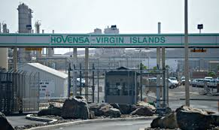
JANUARY 18TH
2012: After 45 years in operation as the territory’s largest private employer, HOVENSA announced that the 350,000-barrel-per-day refinery will shut down and more than 2,000 employees will be dismissed.
Courtesy of
Source: http://highbeam.com/doc/1P2-30537848.html

Slide 24
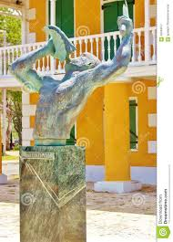
JANUARY 19TH
1792: A survey list revealed that there were 183 free, black men, women, and children living in Frederiksted, St. Croix.
Courtesy of
Text: Black Facts from the Facts Man, Wayne “Facts Man” Adams

Slide 25
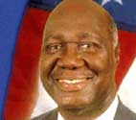
JANUARY 20TH
2006: Governor Charles W. Turnbull signed an executive order creating a task force to study the feasibility of establishing a stock exchange in the territory.
Courtesy of
Source: Daily News 1/3/2007 page. 4

Slide 26

JANUARY 21ST
2009: President Barack Obama was inaugurated in the capital of the United States, Washington, D.C.
Courtesy of
Source: Daily News 1/21/2009 page. 59

Slide 27

JANUARY 22ND
2016: The USVI Department of Health received laboratory confirmation of a case on 22 January. The patient was a non-pregnant woman from USVI who reported the onset of fever, rash, conjunctivitis and arthralgia on 1 January. She had not travelled in the three weeks that preceded the onset of symptoms. A serum sample obtained from the patient on 8 January tested IgM positive at the U.S. Centers for Disease Control and Prevention.
Courtesy of
Source: www.who.int/csr/don/29-january-2016-zika-usa/en/

Slide 28
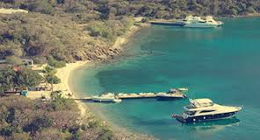
JANUARY 23RD
1974: Students from 6 Midwestern colleges spent a term studying a course, “The Virgin Islands Past & Present”. They spent some time in the Virgin Islands and posed for the January 23rd issue of the Daily News.
Courtesy of
Source: Daily News 1/23/1974 page. 5

Slide 29
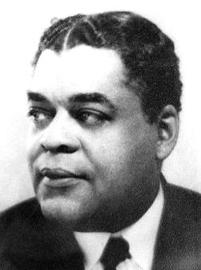
JANUARY 24TH
1874: Arthur A. Schomburg was born on the island of Puerto Rico of Virgin Islands parents, where he spent a portion of his life. He was a noted historian, writer, bibliophile and collector of African-American, documents, books and artifacts in New York. He was involved in Numerous social and political struggles of Cuba and Puerto Rico. The Schomburg collection in New York stands as a tribute to his life’s work.
Courtesy of
Text: January 24, 1874 From These Shores by Axel C. Hansen page. 221

Slide 30
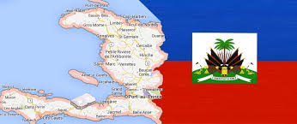
JANUARY 25TH
2006: Eunice Charles, 18 months, drowned as she, her mother and others try to enter St. Thomas illegally from Haiti. Her tragic death sparked community support for a proper burial.
Courtesy of
Source: Daily News 1/3/2007 page. 4

Slide 31
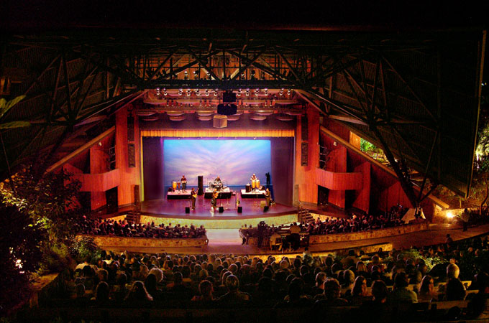
JANUARY 26TH
2007: Sashay, Promenade and ladies chain was a few of the calls chanted from the floor as the Caribbean ritual dancers in colorful madras swirl across the stage of the Reichold Center for the Arts in “Playing Ring: A Journey into Quadrille”.
Courtesy of
Source: Daily News 1/26/07 page. W-5

Slide 32
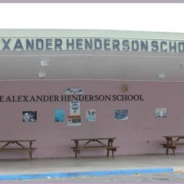
JANUARY 27TH
1842: The La Vallee School name was changed to the Alexander Henderson School and was opened in St. Croix.
Courtesy of
Source: 1/27/1977 page. 17

Slide 33
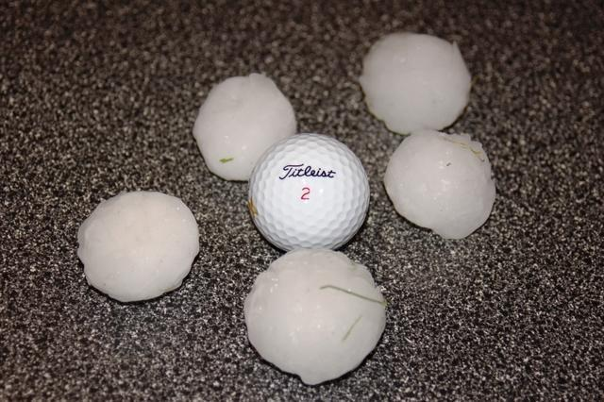
JANUARY 28TH
1969: The St. Croix Avis reported that the day before, 75 miles per hour winds brought driving rains, a water spout and hailstones the size of golf balls to the east end of St. Croix causing $1,000s in damages to houses and property.
Courtesy of
Source: St. Croix Avis dated 1/28/1969 page. 1

Slide 34

JANUARY 29TH
2009: The V.I Tourism Department Launched a $250,000 website to lure higher Internet traffic and ultimately bring more tourist dollars to the territory.
Courtesy of
Source: Daily News 1/29/2009 page. 2

Slide 35
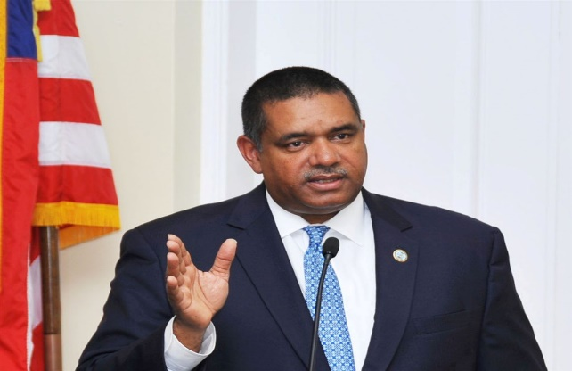
JANUARY 30TH
2012: About 100 demonstrators gathered across the V.I. Legislature to voice their concerns, frustrations and cases over the state of life in the Virgin Islands. Feeling pushed close to the brink, they drew close to steel barricades lining Veterans Drive, Chanting in unison and leaning into the roadway to wave signs at passing traffic. The noise could be heard from inside the Legislature chambers as Governor John DeJongh Jr. gave his state of the territory address.
Courtesy of
Source: http://highbeam.com/doc/1P2-30616319.html

Slide 36
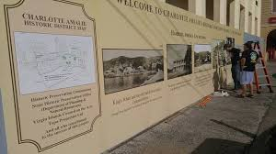
JANUARY 31ST
1914: The roof of the Hamburg American Line building roof was raised. It also housed the Imperial German Consulate and Later became Headquarters for the U.S. Navy. Subsequently, it housed the U.S. District Court.
Courtesy of
Source: Daily News 1/31/1977 page. 13

Slide 37
To receive monthly complimentary electronic
Historical Cultural Calendar,
kindly contact …..
Virgin Islands Department of Education
Division of Virgin Islands Cultural Education
ST. THOMAS / ST. JOHN
Mailing Address: 1834 Kongens Gade, STT, VI 00802
Physical Address: J. Antonio Jarvis Annex, STT, VI 00802
Telephone Number: 340-774-0100 x: 2804, 8043, 2806, 2808, or 2809
Fax Number: 340-777-4342
Email Addresses: yohance.henley@vide.vi; mmartin@vide.vi; vbryson@vide..vi
Website Addresses: www.vide.vi/ or http://viculturaled.vide.vi
Building Our Future Through
Education, History and Culture!

