Slide 1





November 2016
HISTORICAL CULTURAL CALENDAR
Compliments of:
Virgin Islands Department of Education
Division of Virgin Islands Cultural Education
Building Our Future Through
Education, History and Culture!

Slide 2
*** November 2016 ***

Slide 3
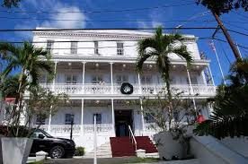
St. Thomas– Charlotte Amalia, Government House
Courtesy of
Text: Division of Virgin Islands Cultural Education
Picture: https://www.pinterest.com/pin/60165344997497232/

Slide 4
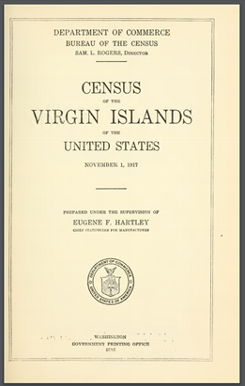
NOVEMBER 1st:
1971: a census of the Virgin Islands was ordered to be taken as of November 1, 1917, and Mr. Eugene F. Hartley, chief statistician for manufactures of the Census Bureau,
was designated as
supervisor in charge.
Courtesy of
Text & Picture:: https://www.census.gov/history/pdf/1917usvi.pdf

Slide 5
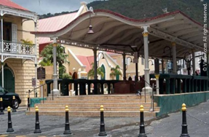
NOVEMBER 2nd :
1995: The public works department has repaired the old market and in record time, the spot which is fast becoming of the show pieces of the islands certainly need attention for a long time
Courtesy of
Text: Thoughts Along The Way, Ariel Melchior pg. 229
Picture: wikki

Slide 6
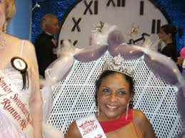
NOVEMBER 3rd:
2009 Toya Andrew the 70 year old Native American storyteller, distinguished toastmaster, and Harvard graduate won the Ms. Senior Sweetheart pageant of American/International. The native Virgin Islander enjoyed
and appreciated
life, swimming,
kayaking, singing,
dancing on stilts and
walking the beach with
her husband.
Courtesy of
Text & Picture:: https://www.census.gov/history/pdf/1917usvi.pdf

Slide 7
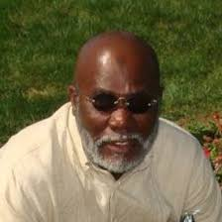
NOVEMBER 4th:
2008 Two men were named 2009 teacher of the year in their respective districts. Charles H. Emmanuel Elementary School math teacher Kenneth Selkdridge and Charlotte Amalie
High School math
teacher Edney
Freeman. Both men
Have a passion
for teaching and
a love of
their craft.
Courtesy of
Text & Picture:: https://www.census.gov/history/pdf/1917usvi.pdf

Slide 8
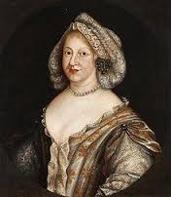
NOVEMBER 5th:
1752: The Danish Frigate Princess Wilhelmine Caroline, captained by Nicolai Hoyer, was homeward bound from a voyage to Guinea and St. Thomas when it went down somewhere on the coast of Jutland. The ship, named for one of the daughters
of King Frederick
the Fifth of Denmark,
was a part of the
Danish West Indian
Company’s fleet
used under the plan
of 1747to revive the
company’s
fortunes.
Courtesy of
Text & Picture:: https://www.census.gov/history/pdf/1917usvi.pdf

Slide 9

NOVEMBER 6th:
2008 Seven students and an administrator from the University of the Virgin Islands were awarded the opportunity to witness the historical inauguration of Barack Obama as the 44th president of the United States in January. The various UVI students are members of the Golden Key Honour society on the St. Croix campus.
The students were
Melina Moore, Wayne
Petersen, Diane DaCosta,
Renako Wells, Nickaya
Armantranding, Sharmane
Simon and Leana Timothy
Courtesy of
Text & Picture:: https://www.census.gov/history/pdf/1917usvi.pdf

Slide 10
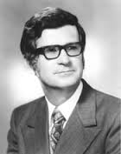
NOVEMBER 7th:
1978
Luis – Millin beat De-Lugo-Dawson, Evans defeated Watlington and the Democrats won 12 of 15 seats.
Courtesy of
Text & Picture:: https://www.census.gov/history/pdf/1917usvi.pdf

Slide 11
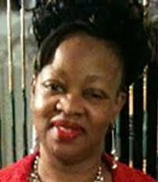
NOVEMBER 8th:
1965 Lucian Stout, affectionately called Lucy, was born on the island of St. Thomas, United States Virgin Islands on November 8, 1965, to Ella May and the late Voltrage Stout. Although a member of a large family of eleven brothers and sisters, her parents took the time to instill in her strong Christian values. In 1984, she
graduated from
Ivanna Eudora Kean
High School. She later
earned certificates in
medical assistance and
accounting from Edison Job Corps Center, Edison, New Jersey in 1987.
Courtesy of
Text & Picture:: https://www.census.gov/history/pdf/1917usvi.pdf

Slide 12
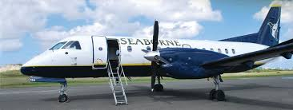
NOVEMBER 9th:
2013 Seaborne Airlines announced that they will launch a new route between Luis Muñoz Marín International Airport in San Juan, Puerto Rico (SJU) and St Kitt’s Robert L. Bradshaw International Airport (SKB), with continuous service to Nevis’ Vance W. Amory International Airport (NEV), beginning Wednesday, January 15th, 2014. The flights will operate daily.
Courtesy of
Text & Picture:: https://www.census.gov/history/pdf/1917usvi.pdf

Slide 13

NOVEMBER 10th:
2013 The Veterans Service Organization of the Virgin Islands and the Office of Veteran Affairs joined the rest of the nation in pausing to observe the annual commemoration
of Veterans Day
on Sunday on
St. John and Monday
on St. Thomas and St. Croix
Courtesy of
Text & Picture:: https://www.census.gov/history/pdf/1917usvi.pdf

Slide 14
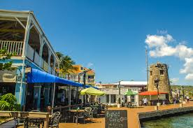
NOVEMBER 11th:
2013 Christiansted boardwalk project announced that it will entail a full replacement of all of the surface pieces of the existing boardwalk.
Courtesy of
Text & Picture:: https://www.census.gov/history/pdf/1917usvi.pdf

Slide 15
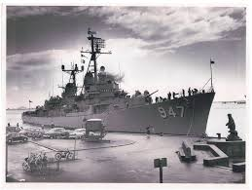
NOVEMBER 12th:
1842
The USS Somers left Cape Mesurado in Liberia bound for St. Thomas in the Danish West Indies. This was it’s second voyage.
Courtesy of
Text & Picture:: https://www.census.gov/history/pdf/1917usvi.pdf

Slide 16
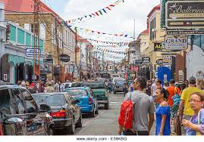
NOVEMBER 13th:
1965
A recent travelogue from Denmark by a St.Thomas traveler stated, " Copenhagon has one shopping area in the center devoted entirely to pedestrians, with no car on the street. The area covers about five blocks. Main St.Thomas will become a similar area as or tourism continues to grow it certainly did!
Courtesy of
Text & Picture:: https://www.census.gov/history/pdf/1917usvi.pdf

Slide 17
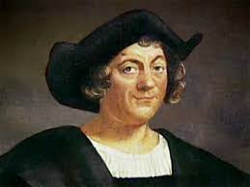
NOVEMBER 14th:
1493 Christopher Columbus anchored outside of Salt River, St. Croix. On this date, the first battle between native Caribs and Europeans took place at Salt River. He later
travelled north
to islands he
named The
Virgin Islands
in honor of St.
Ursula & her
martyred 11,000 virgins.
Courtesy of
Text & Picture:: https://www.census.gov/history/pdf/1917usvi.pdf

Slide 18

NOVEMBER 15th:
2011
The Virgin Islands Water and Power Authority rationed potable water when Unit 11, a steam- generating boiler, sprang leaks and left 5,500 customers on St. Thomas without regularly scheduled water for nine weeks.
Courtesy of
Text & Picture:: https://www.census.gov/history/pdf/1917usvi.pdf

Slide 19
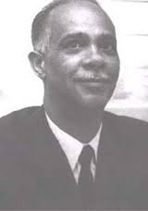
NOVEMBER 16th:
1913 Roy Adelbert Anduze was born on St. Thomas to Carl Adelbert and Mildred Verona (nee Watlington). He was a physician, surgeon, Fellow in Surgery at Howard University, Chief Municipal Physician and Commissioner of Health, Fellow in the American Colleges of Surgeons
and Angiology,and Delegate
to the U.N. General
Assembly, to present,
“Health in Non-Self
Governing Territories”
and CVI Board of
Trustees member.
Courtesy of
Text & Picture:: https://www.census.gov/history/pdf/1917usvi.pdf

Slide 20
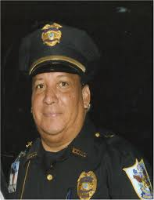
NOVEMBER 17th:
1965 Antolino Carmona was born on November 17 1965 on the Island of St. Thomas to Francisca Maria Ortiz and Serveriano Carmona. He was the second to the last of 20 siblings He was employed by pueblo supermarket for many years and there after went to work at
Lima’s Grocery at Hospital
Ground for almost 15
years. After leaving
Lima’s Grocery, chico
was employed at
Government House and
work for Governor de Jongh
as a security guard for 8 years. Chico was very dedicated to his job and took pride in the security of the Governor.
Courtesy of
Text & Picture:: https://www.census.gov/history/pdf/1917usvi.pdf

Slide 21
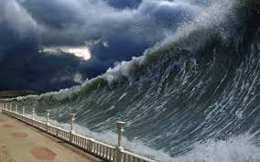
NOVEMBER 18th:
1867 On the afternoon of November 18, 1867, a magnitude 7.5 earthquake occurred in the Anegada trough, located between the US Virgin Islands of St. Croix, and St. Thomas. The earthquake actually
consisted of two
shocks, separated
by ten minutes. These
shocks generated two
tsunami waves that
were recorded at
several Island locations
across the eastern Caribbean region, most notably on the Islands of St. Thomas.
Courtesy of
Text & Picture:: https://www.census.gov/history/pdf/1917usvi.pdf

Slide 22
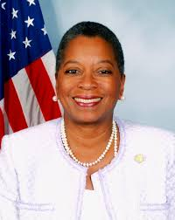
NOVEMBER 19th:
1996
After no one received the necessary 50% plus one votes in the general election for Delegate to Congress, the run-off election between Donna Christian Green and Victor
Frazer was held.
Green beat the
incumbent Frazer
by about
747 votes.
Courtesy of
Text & Picture:: https://www.census.gov/history/pdf/1917usvi.pdf

Slide 23

NOVEMBER 20th:
1702 The Guldenlew, headed on Copenhagen to St. Thomas run, was lost of The Norwegian Coast. It was one of the twenty ships owned by the Danish West Indian Company.
Courtesy of
Text & Picture:: https://www.census.gov/history/pdf/1917usvi.pdf

Slide 24
NOVEMBER 21st:
1948 Born on November 21, 1948 to Leo and Ann-Marie Bryan (Brin), Blaze Bryan was their sixth child and second boy. He was a late bloomer. The doctors told his parents he would never walk, but they never gave up. Blaze grew up in Frenchtown but for many years lived with his sister, Margret in Solberg. He worked as a cook at various local restaurants which included L’Escargot, Bopeep, Cuzzins, and Betsy’s. Blaze retired in 2010.
Courtesy of
Text & Picture:: https://www.census.gov/history/pdf/1917usvi.pdf

Slide 25
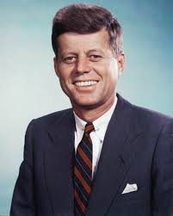
NOVEMBER 22nd:
1963
The Virgin Islands community plunged into shock on hearing of the assassination of President John F. Kennedy, In Texas. Kennedy was fatally wounded by several contested
gunshots as he
rode in a
presidential
motorcade in Dealey Plaza, Dallas
Courtesy of
Text & Picture:: https://www.census.gov/history/pdf/1917usvi.pdf

Slide 26
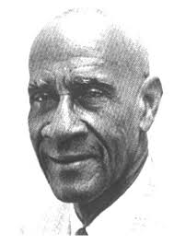
NOVEMBER 23rd:
1987 Alton Adams, Sr. passed away. Alton Augustus Adams, Sr., was a musician, writer, hotelier, and the first black
bandmaster
of the United
States Navy.
Born in the
Virgin Islands
in 1889, Adams joined the U.S. military in 1917.
Courtesy of
Text & Picture:: https://www.census.gov/history/pdf/1917usvi.pdf

Slide 27
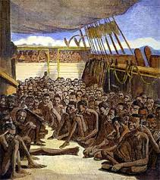
NOVEMBER 24th:
1685
The Brandenburg Company entered into an agreement with Denmark to import captives from Africa..
Courtesy of
Text & Picture:: https://www.census.gov/history/pdf/1917usvi.pdf

Slide 28
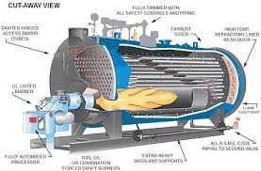
NOVEMBER 25th:
2008 The islands of St Thomas and St John in the US Virgin Islands were without electricity for nearly a day and a half following a explosion of a boiler-tube generator at the Randolph E. Harley Facility in Crown Bay, St Thomas.
Courtesy of
Text & Picture:: https://www.census.gov/history/pdf/1917usvi.pdf

Slide 29

NOVEMBER 26th:
1968 Stephanos O’Reilly and Ariel Melchoir invited Residents of the U.S. Virgin Islands to join a new political party with which they were affiliated. The party was called the independent citizens movement or I-C-M.
Courtesy of
Text & Picture:: https://www.census.gov/history/pdf/1917usvi.pdf

Slide 30
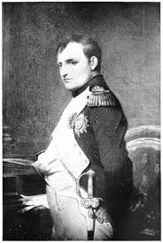
NOVEMBER 27th:
1922 An editorial, written by Acting editor of The Emancipator, Grenada native Thomas Fitzhugh Morenga-Bonaparte, appeared in The Emancipator criticizing the
St. Thomas police.
This led to his
deportation by
Governor Henry
Courtesy of
Text & Picture:: https://www.census.gov/history/pdf/1917usvi.pdf

Slide 31
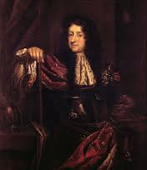
NOVEMBER 28th:
1674
King Christian the fifth of Denmark issued an edict allowing the Danish West India Company to trade on the guinea coast.
Courtesy of
Text & Picture:: https://www.census.gov/history/pdf/1917usvi.pdf

Slide 32
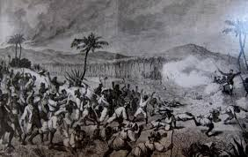
NOVEMBER 29th:
1878 The Council of Ministers called the Statsroad that dealt up all the laws and important government matters, discussed the Labor Riot only once without resolutions or proposals.
Courtesy of
Text & Picture:: https://www.census.gov/history/pdf/1917usvi.pdf

Slide 33
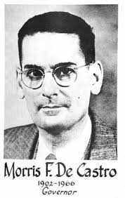
NOVEMBER 30th:
1949 Democrat Morris Fidanque de Castro was named the fifth civilian Govenor of The U.S. Virgin Islands. De Castro was the first
native born
Govenor of
the islands
as a U.S.
Courtesy of
Text & Picture:: https://www.census.gov/history/pdf/1917usvi.pdf

Slide 34
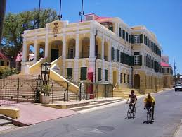
Government House in
Christiansted, St. Croix
Courtesy of
Text: Division of Virgin Islands Cultural Education
Picture: https://www.pinterest.com/pin/60165344997497232/

Slide 35
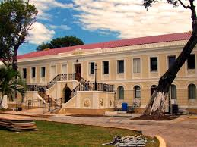
St. Thomas Legislature
Courtesy of
Text: Division of Virgin Islands Cultural Education
Picture: https://www.pinterest.com/pin/60165344997497232/

Slide 36
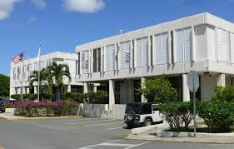
St. Croix Legislature
Courtesy of
Text: Division of Virgin Islands Cultural Education
Picture: Google.com

Slide 37
To receive monthly complimentary electronic historical cultural calendars, kindly contact …..
Virgin Islands Department of Education
Division of Virgin Islands Cultural Education
ST. CROX
2133 Hospital Street; St. Croix, VI 00820
Telephone Number: 340-773-1095 x: 7032
Fax Number: 340-773-4476
ST. THOMAS / ST. JOHN
Mailing Address: 1834 Kongens Gade; STT, VI 00802
Physical Address: J. Antonio Jarvis Annex; STT, VI 00802
Telephone Number: 340-774-0100 x: 2808, 2806, or 2804
Fax Number: 340-777-4342
Email Addresses: vbryson@stx.k12.vi; mmartin@sttj.k12.vi; Yohance.henley@vide.vi
Building Our Future Through
Education, History and Culture!

