Slide 1





October 2016
HISTORICAL CULTURAL CALENDAR
Compliments of:
Virgin Islands Department of Education
Division of Virgin Islands Cultural Education
Building Our Future Through
Education, History and Culture!

Slide 2
*** SPECIAL TRIBUTE ***
EDUCATIONAL INSTITUTIONS
SERVING THE CHILDREN
OF THE
UNITED STATES VIRGIN ISLANDS

Slide 3
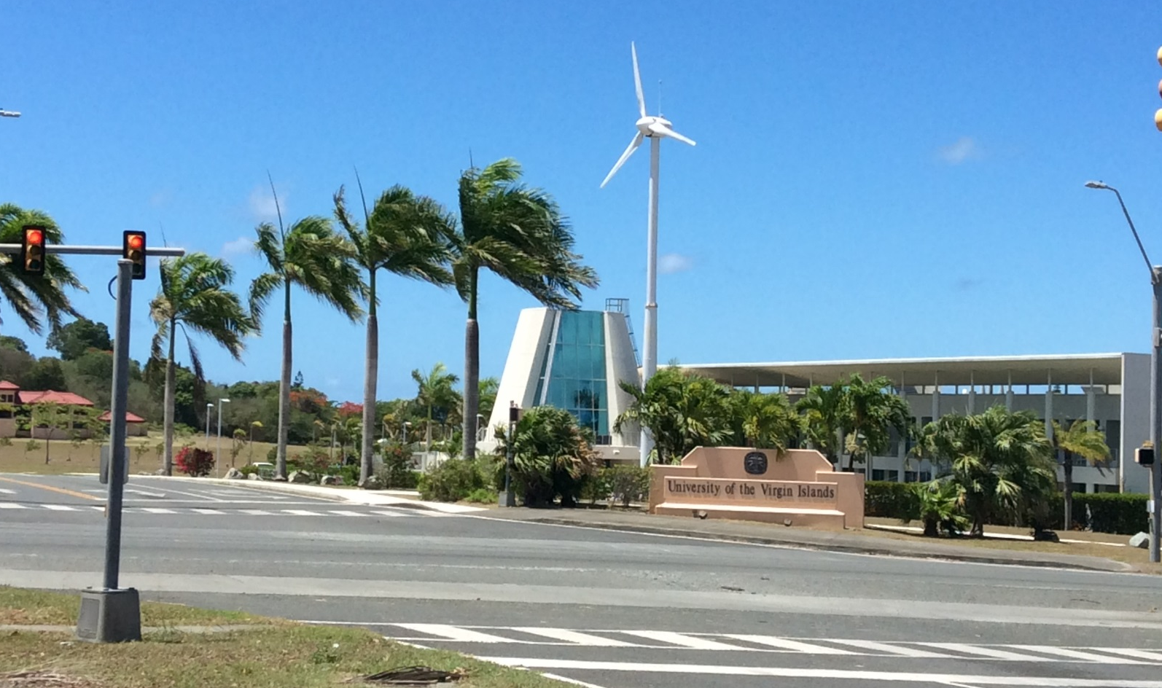
University of the Virgin Islands – STX Campus
Courtesy of
Text & Picture: Division of Virgin Islands Cultural Education

Slide 4
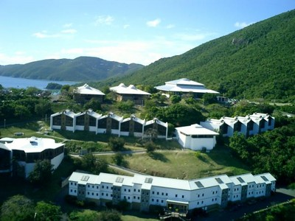
University of the Virgin Islands – STT Campus
Courtesy of
Text: Division of Virgin Islands Cultural Education
Picture: http://southeastgenetics.org/directory/location_details.php/35/University_of_the_Virgin_Islands

Slide 5
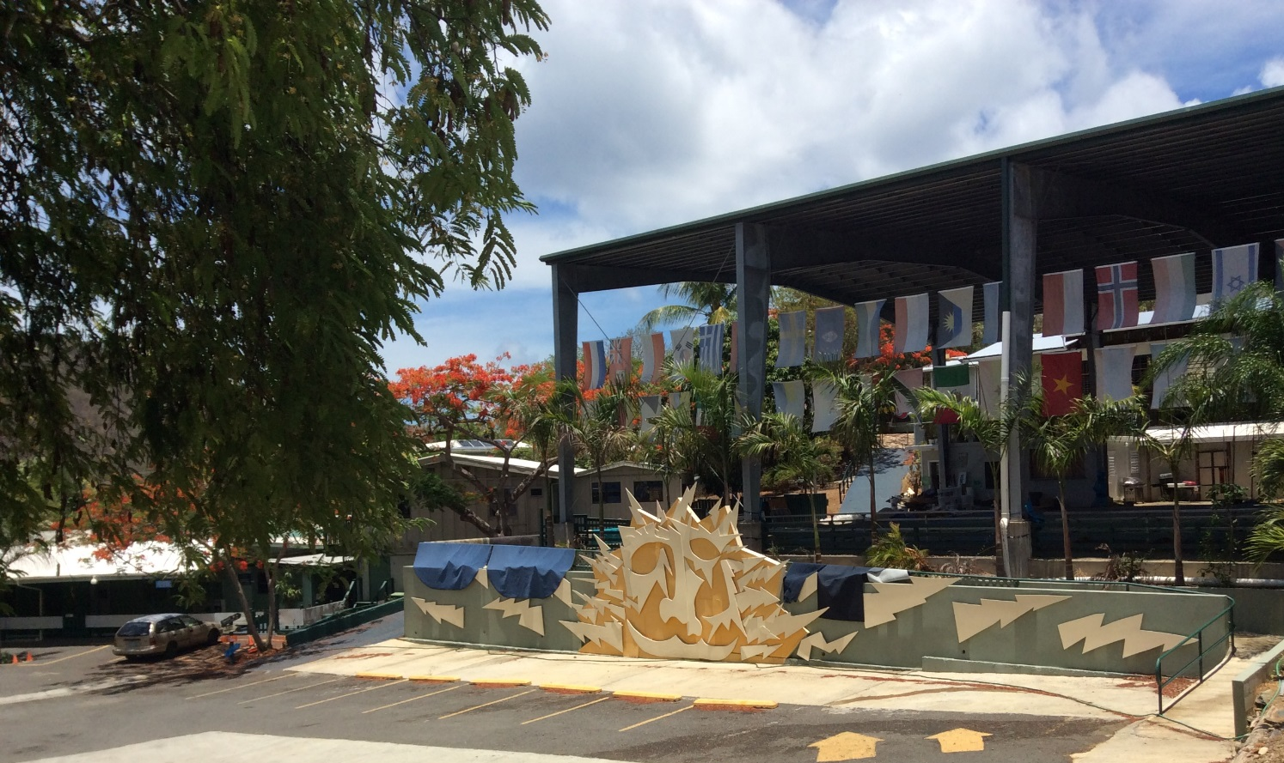
VI Montessori School and Peter Gruber International Academy - STT
Courtesy of
Text: Division of Virgin Islands Cultural Education
Picture: http://www.spps.vi/pages/accreditation-26

Slide 6
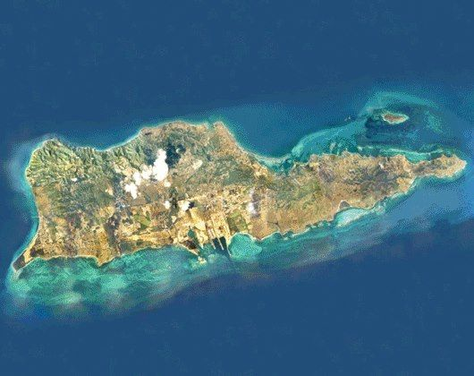
Virgin Islands Behavioral Services - STX
Courtesy of
Text: Division of Virgin Islands Cultural Education
Picture: http://www.spps.vi/pages/accreditation-26

Slide 7
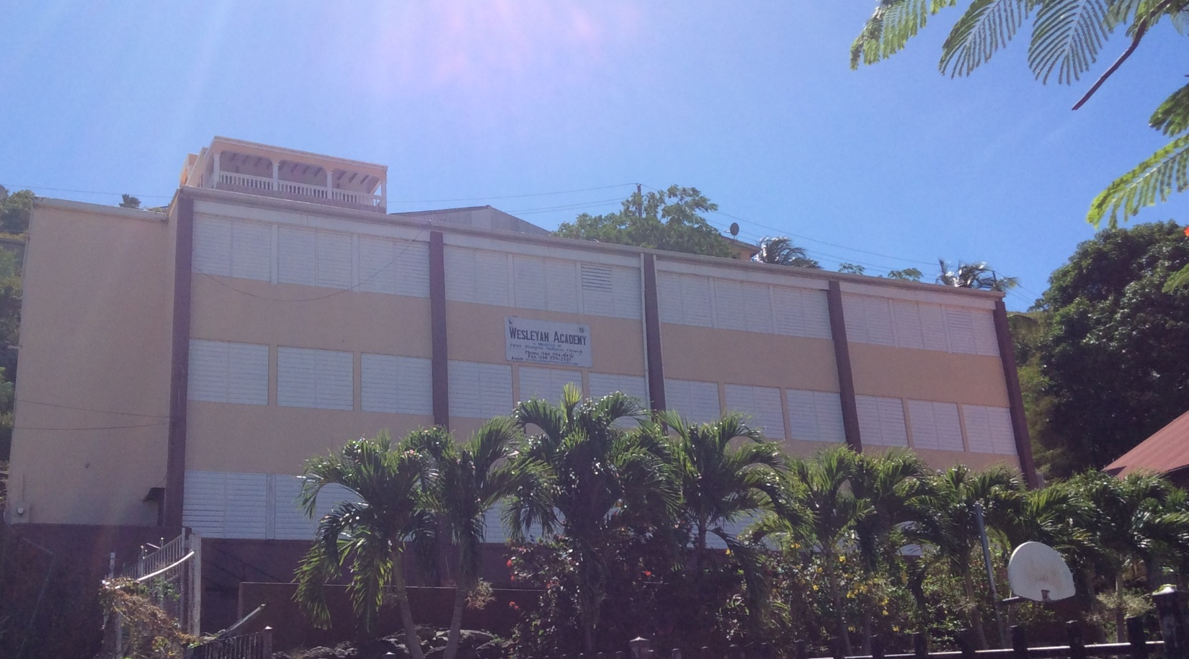
Wesleyan Academy - STT
Courtesy of
Text: Division of Virgin Islands Cultural Education
Picture: http://www.spps.vi/pages/accreditation-26

Slide 8
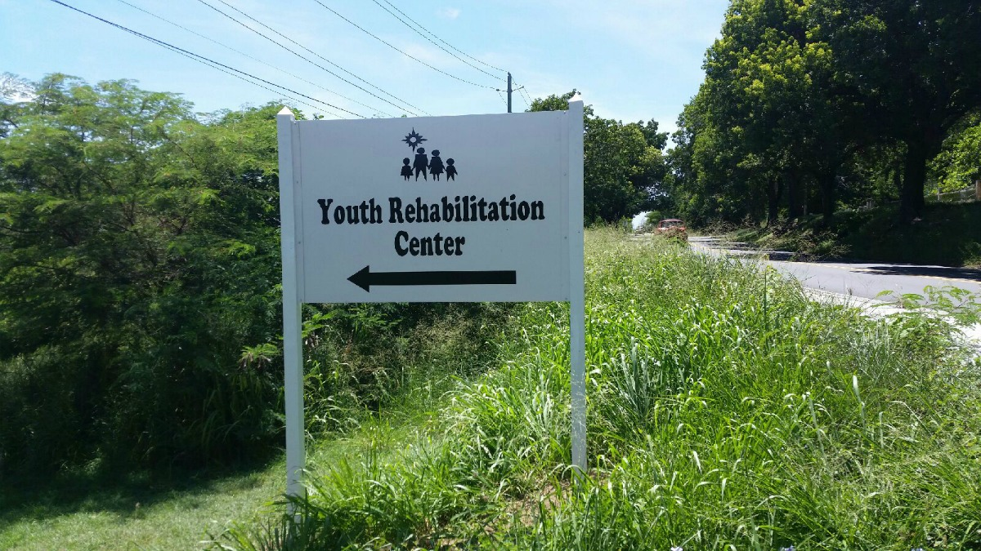
Youth Rehabilitation Center - STX
Courtesy of
Text: Division of Virgin Islands Cultural Education
Picture: http://viconsortium.com/

Slide 9
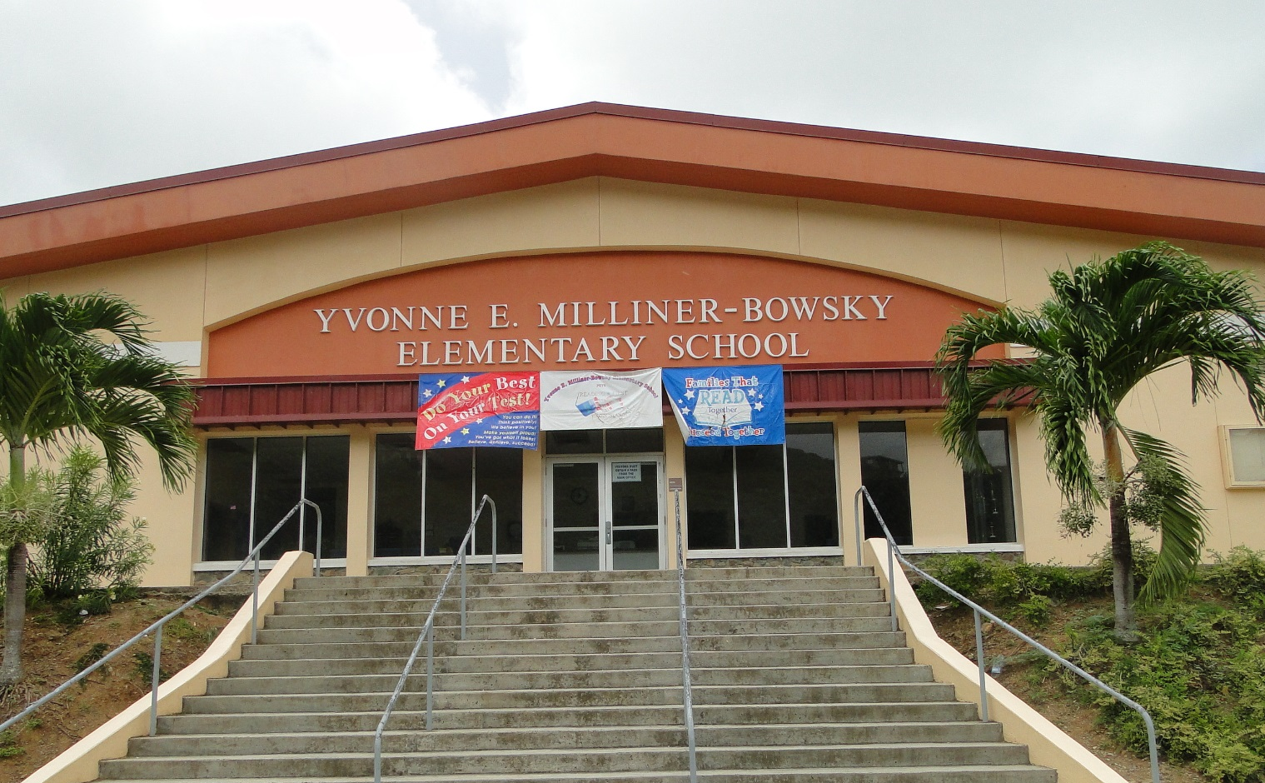
Yvonne E. Milliner-Bowsky Elementary School - STT
Courtesy of
Text: Division of Virgin Islands Cultural Education
Picture: http://www.spps.vi/pages/accreditation-26

Slide 10

Courtesy of
Picture: https://www.theodysseyonline.com/thank-you-letter-to-the-ymca

Slide 11

Courtesy of
Picture: http://www.idealist.org/view/nonprofit/mNKw8nkdxWSP/

Slide 12

Courtesy of
Picture: https://www.theodysseyonline.com/quick-thank-you-to-mom-and-dad

Slide 13
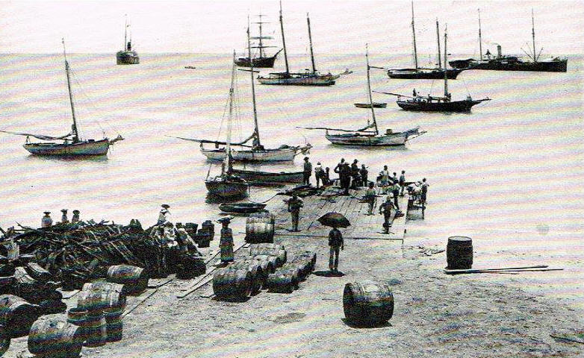
OCTOBER 1st:
1780:
Two large American ships sought protection from four privateers in Frederiksted Harbor. Since the privateer ships were in Danish waters, they were fired upon by Danish forces occupying the Frederiksted Fort.
Courtesy of
Text: Today in VI History
Picture: http://www.viport.com/about/history.html

Slide 14

OCTOBER 2nd:
1969:
Concerns were voiced about a published article by the New York Times. It is unfortunate that the excellent series of articles about the Virgin Islands, which was recently published by the New York Times, contained several inaccuracies. For example, the author stated there were ‘taxicabs in the Virgin Islands with slogans printed on their sides that read: ‘Kill the while pigs.’” The misleading and exaggerated statements were deplored.
Courtesy of
Text: Thoughts Along The Way, Ariel Melchoir, Sr., page 423
Picture: http://www.newspapers.psu.edu/home-2/nyt/

Slide 15
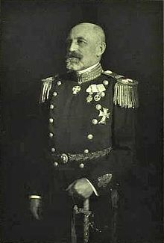
OCTOBER 3rd:
1916:
Henri Konow, captain of the Valkyren and interim Governor of the Danish West Indies, took office. He succeeded Lars Helweg-Larsen. He held office until St. Croix, St. John, St. Thomas, and certain adjacent cays were transferred to the US. He was of the 42 men who presided over the islands between 1735 and 1917.
Courtesy of
Text: Today in VI History
Picture: https://en.wikipedia.org/wiki/Henri_Konow

Slide 16
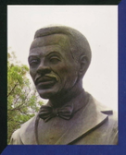
OCTOBER 4th:
1985:
Act #5098 was approved to establish the Rothschild Francis Day. He was known to be a champion of civil rights.
Courtesy of
Text: Legislative Archives
Picture: http://www.vintagevirginislands.com/blog/remembering-rothschild-polly-francis-in-the-us-virgin-islands-1930s

Slide 17
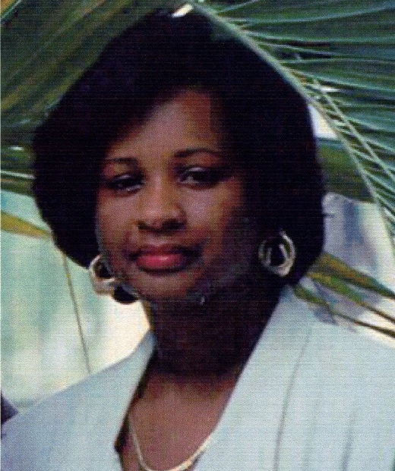
OCTOBER 5th:
1965:
Diane Leonie Hansen was born. She was an outstanding cook. Most of her adult life, she worked as an Administrative Officer with Port Authority.
Courtesy of
Text & Picture: Funeral Booklet

Slide 18

OCTOBER 6th:
1981:
Resolution #1051 was passed to recognize Brian Morrissette for his diligent efforts and accomplishments in representing the VI in track and field.
Courtesy of
Text: Legislative Archives
Picture: https://www.pinterest.com/pin/243827767302025401/

Slide 19
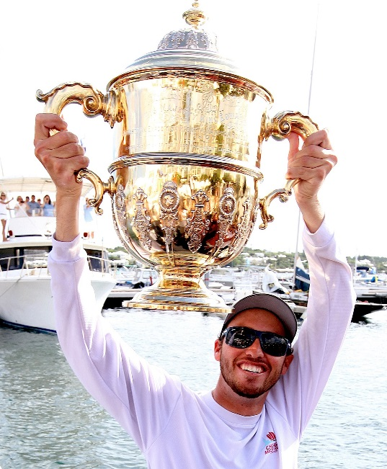
OCTOBER 7th:
2012:
Taylor Canfield, US Virgin Islands sailor, made a big statement when he took a 3-0 victor over Johnie Bernstsson at the Argo Group Gold Cup in Hamilton, Bermuda. With the win, St. Thomas native racing was in the 9th place with 41 points in the Alpari World Match Racing Tour Standings.
Courtesy of
Text: Virgin Islands Daily News, Monday, October 8, 2012, page 56
Picture: http://www.caribbeanregatta.com/argo-group-gold-cup-stage-1-qualifying-groups/

Slide 20
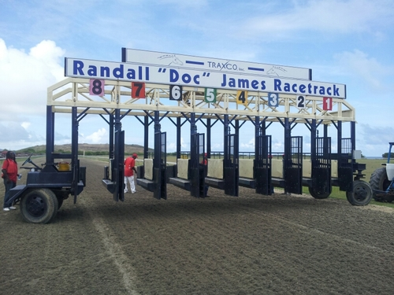
OCTOBER 8th:
1992:
Act #5813 was passed to honor Dr. Randall Nicholas ’Doc’ James. In his honor, the Flamboyant Race Track was also renamed the Randall ‘Doc’ James Racetrack.
Courtesy of
Text: Legislative Archives
Picture: https://twitter.com/traxcoincvi

Slide 21
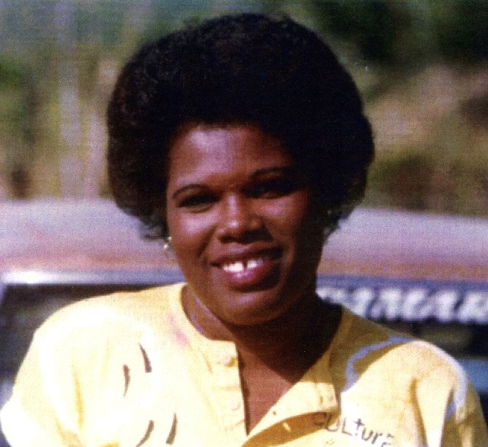
OCTOBER 9th:
1961:
Marie Bernadette Thurland was born on St. Martin. She moved to St. Croix and began her teaching career at the Community United Methodist School and Day Care Center. Later she taught at various schools on St. Croix and the mainland including St. Patrick’s School and The School of the Good Shepherd.
Courtesy of
Text & Picture: Funeral Booklet

Slide 22
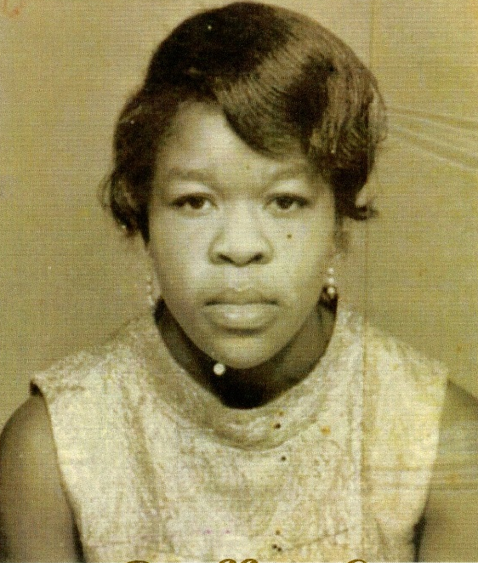
OCTOBER 10th:
1944:
Janette Cuffy Lawrence was born in Riviere Cyrique, Dominica. She was a homemaker. As a great chef, her famous specialties included rice and red bean with chicken, stew peas, dumpling soup and mixed drinks.
Courtesy of
Text & Picture: Funeral Booklet

Slide 23
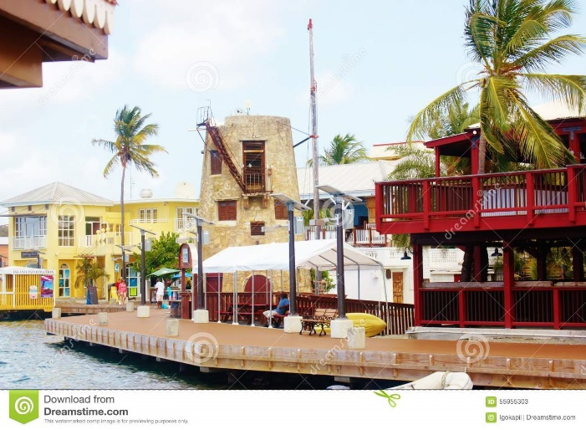
OCTOBER 11th:
2013:
The Virgin Islands Daily News announced construction began in surfacing of the Christiansted Boardwalk. The restoration project entailed a full replacement of all surface pieces of the existing boardwalk. Hugging most of the Christiansted Harbor, it stretches from east from the Seaborne Airlines to the west at the King Christian Hotel in the downtown area.
Courtesy of
Text: https://www.highbeam.com/doc/1P2-35226429.html
Picture: https://www.dreamstime.com/editorial-stock-photo-christiansted-boardwalk-us-virgin-islands-one-landmark-st-croix-its-where-visitors-can-have-chance-to-test-fresh-fish-image55955303

Slide 24
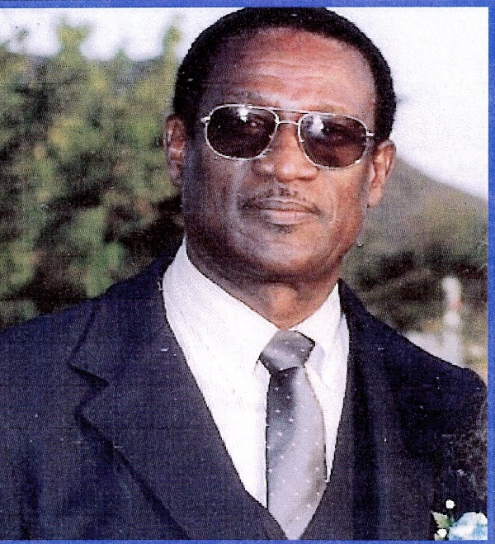
OCTOBER 12th:
1932:
Neville Ansel Brathwaite was born in San Nicholas, Aruba. He formed the first Aruban Sports Organization. After relocating to St. Croix, he worked at Harvey Alumina Corp. (Martin Marietta) and later as Chief Supervisor of Area 4 at Hess Oil Corp. He also managed Vicrete Building Products. He served as President for the St. Patrick’s and St. Joseph Home School Associations and the William’s Delight Homeowner’s Association.
Courtesy of
Text & Picture: Funeral Booklet

Slide 25
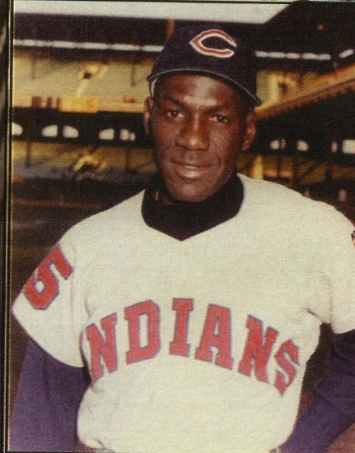
OCTOBER 13th:
1925:
Valmy Thomas, Sr. was born in Santurce, Puerto Rico. As a resident of St. Croix, he learn the trade of carpentry while a student. He served in the US Navy during World War II. He was the first Virgin Islander to play Major League Baseball. He was the first local businessman to bring the Small Business Administration to St. Croix. He worked at the Bureau of Recreation with the Department of Education and with the Department of Conservation and Cultural Affairs.
Courtesy of
Text & Picture: Funeral Booklet

Slide 26

OCTOBER 14th:
1965:
“Partners in Freedom – newspapers and readers,” was echoed as an appropriate theme for this year’s observance of newspaper week. Freedom of press is a privilege, which must be guarded with diligence and used with caution, dignity, and good sense. It is not only a privilege. It carries with it a tremendous obligation.
Courtesy of
Text: Thoughts Along the Way, Ariel Melchoir, Sr., page 353
Picture: http://www.virginislandsdailynews.com/

Slide 27
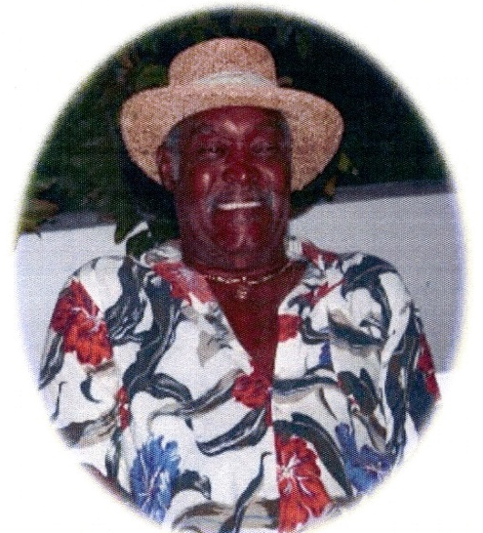
OCTOBER 15th:
1943:
Orendo D. Allen was born in Frederiksted, St. Croix. At a young age, he took an interest in heavy machinery, as a result his lifelong career was an operator of heavy equipment. He was chef extraordinaire, who was big on conch and fungi and Puerto-Rican-style seasoned rice. He was known as the Mayor under the Tippet tree, the Almond tree, and “Under the Chandelier”.
Courtesy of
Text & Picture: Funeral Booklet

Slide 28
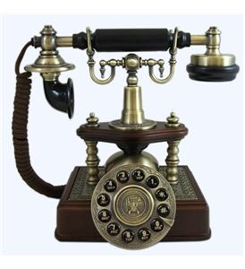
OCTOBER 16th:
1934:
When the Virgin Islands Company’s plans were first made public, a storm of protest arose in St. Croix. Oppositions of every kind were let loose. Delegates spent public money in mad race to Washington to arrest the march of social adjustment under the New Deal.
Courtesy of
Text: Thoughts Along the Way, Ariel Melchoir, Sr., page 42
Picture: http://www.payphoneoutlet.com/antique-phonesnovelty-phonesretro-phones-c-111.html

Slide 29
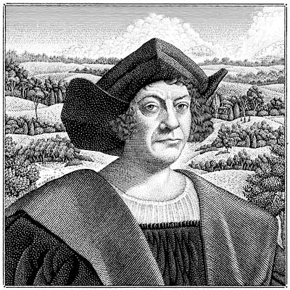
OCTOBER 17th:
1493:
Christopher Columbus began his second voyage to the New World. This Italian explorer sailed with 17 smaller boats called Caravels, not with the larger boats - Nina, Pinta, and Santa Maria - as he did on his first voyage.
Courtesy of
Text: Today in VI History
Picture: http://www.beyond-black-friday.com/category/holidays-2/

Slide 30
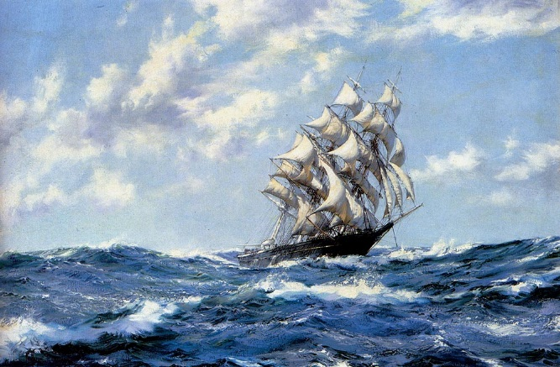
OCTOBER 18th:
1700:
Governor Johan Lorentz reported to the directors of the Danish West India Company that Tempest Rogers, a madagascar pirate and former friend of the infamous Captain Kidd, appeared in St. Thomas. He asked permission to remain on the island to have his boat repaired. Governor Lorentz refused his request.
Courtesy of
Text: Today in VI History
Picture: http://paulinespiratesandprivateers.blogspot.com/2011/08/sailor-mouth-saturday-all.html

Slide 31

OCTOBER 19th:
1818:
The Harmonic Lodge 346 was founded in the Danish West Indies. Although there were two other lodges in the territory, they didn’t admit freed Blacks or Jews. So a special petition was made to the Grand Lodge of England and the request was approved. When the territory was sold in 1917, the Harmonic Lodge 346 was the only English Lodge on American soil.
Courtesy of
Text: Today in VI History
Picture: http://harmoniclodge.com/blog-news-2/

Slide 32
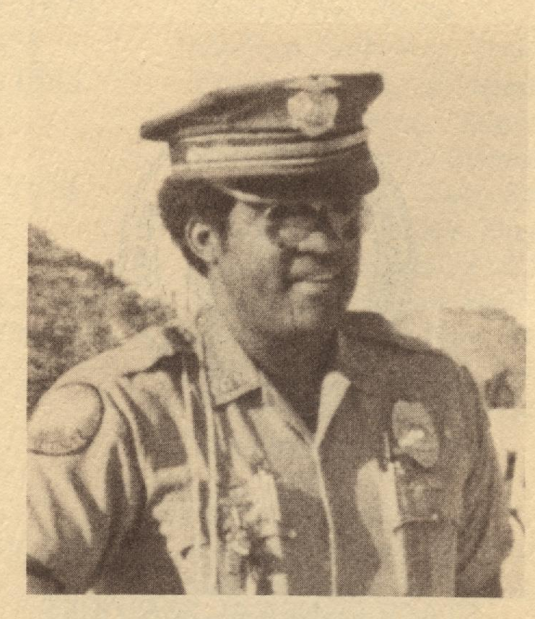
OCTOBER 20th:
1981:
Act #4651 was approved to establish the Richard Nicholas Callwood Scholarship for studies in Political Science and Administration.
Courtesy of
Text: Legislative Archives
Picture: Funeral Booklet

Slide 33

OCTOBER 21st:
1988:
An adult education scholarship program was provided through the passage of Act #5368.
Courtesy of
Text: Legislative Archives
Picture: http://www.saeopp.org/scholarships

Slide 34
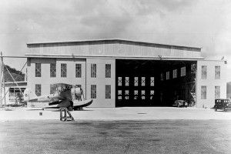
OCTOBER 22nd:
1969:
After a near crash occurred at Harry S. Truman Airport last week, the skill action of a veteran pilot finally brought the jet aircraft under control. It was reported that it touched down on the slippery pavement and was unable to stop in the usual area. Eyewitnesses and the community urged Port Authority to take concrete steps to protect the lives of air travelers here … now not next year.
Courtesy of
Text: Thoughts Along The Way, Ariel Melchoir, Sr., page 427
Picture: https://www.pinterest.com/pin/201465783307560198/

Slide 35
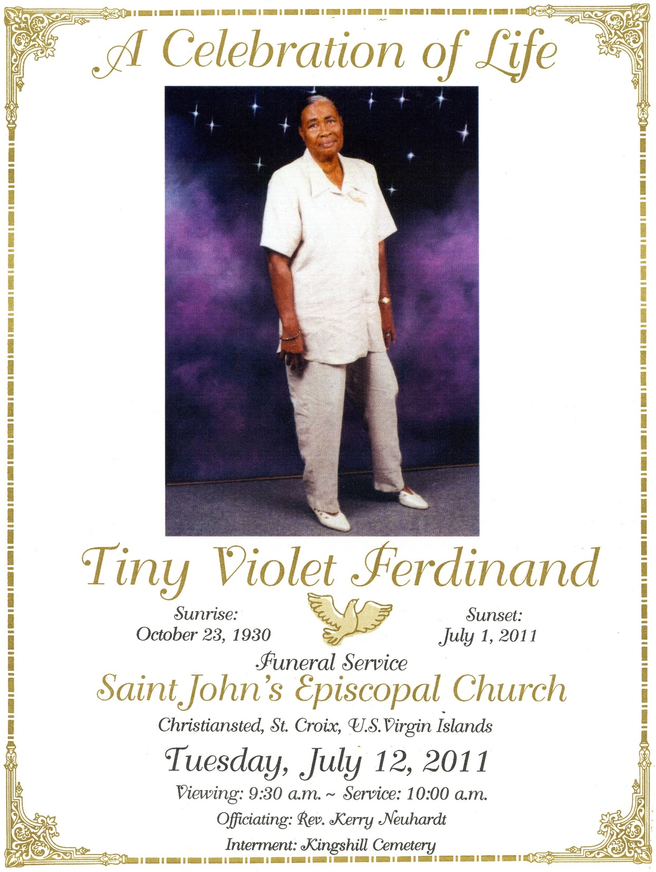
OCTOBER 23rd :
1930:
Tiny Violet Ferdinand was born in Ebenezer, Antigua. In her early years, she worked in her aunt’s dairy farm in Peter’s Rest, which had undeveloped farmland in the surrounding areas. Later she work with the VI Department of Social Services. She was an accomplished seamstress, talented artist, excellent cook and incredible gardener.
Courtesy of
Text & Picture: Funeral Booklet

Slide 36
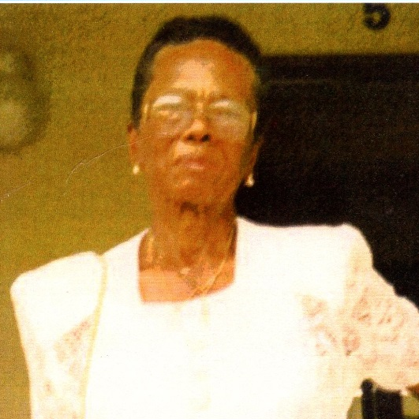
OCTOBER 24th:
1920:
Mary Eliza Harris Lee was born in Christiansted, St. Croix. She enjoyed sewing crafts, cooking and baking especially. She was employed by Mrs. Asta Fleming’s Guest House, Good Hope Hotel, and Christian’s Restaurant in Christiansted as a cook.
Courtesy of
Text & Picture: Funeral Booklet

Slide 37

OCTOBER 25th:
1791:
Reverend S. R. Ortwood suspended Hurricane Thanksgiving services, due to an approaching hurricane.
Courtesy of
Text: Today in VI History
Picture: http://www.sintmaartengov.org/PressReleases/Pages/Give-Thanks-At-All-Times-the-17th-Annual-Thanksgiving-Service-to-be-held-Sunday-.aspx

Slide 38
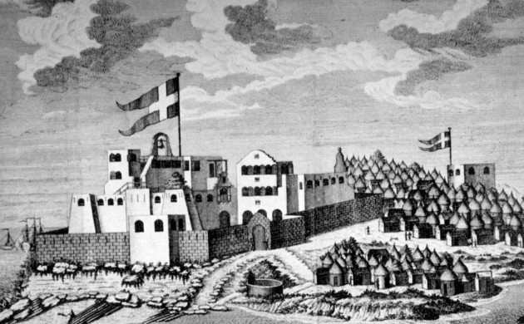
OCTOBER 26th:
1798:
Thomas Demalville’s two year term as the 12th Governor General of the Danish West Indies ended. After his conversion to the Moravian faith, he donated the tract of land for St. John’s Emmaus Moravian Church. He established compulsory Sunday School for slaves and translated the Bible into Dutch Creole, so they could receive Christian instruction.
Courtesy of
Text: Today in VI History
Picture: http://cphpost.dk/history/the-akwamu-the-beginning-of-the-end-of-danish-colonial-power.html

Slide 39
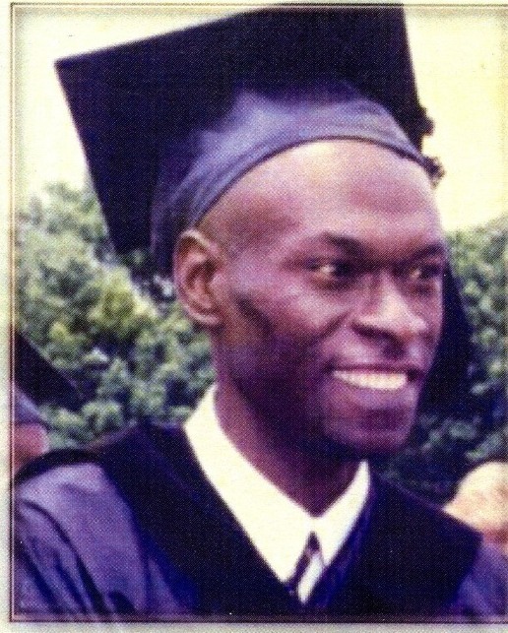
OCTOBER 27th:
1964:
David Samuel Semper was born on Antigua. As a lad at Central High School in St. Croix, he was the secretary of the Martin Marrietta Vocational Program. He worked as a bookkeeper for several years. Using crutches due to a permanent injury, his commitment and perseverance paid off when he graduated Cum Laude with a Bachelor’s degree in Business Administration and Associates degree in Computer Science.
Courtesy of
Text & Picture: Funeral Booklet

Slide 40

OCTOBER 28th:
1975:
Through Resolution #770 Teresita Thomas Nunez was honored and congratulated for 48 year of public service as an educator.
Courtesy of
Text: Legislative Archives
Picture: http://educator.leonschools.net/

Slide 41
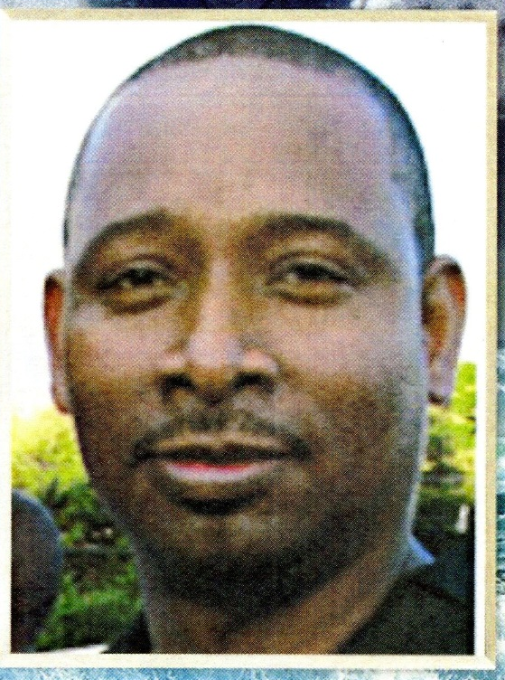
OCTOBER 29th:
1970:
Wayne Samuel Hawley, Sr. was born on St. Croix. As a carpentry apprentice in his formative years, he became a good carpenter building first class cabinets. He also worked as a Process Operator A at Hovensa. His hobbies included fishing and gardening.
Courtesy of
Text & Picture: Funeral Booklet

Slide 42
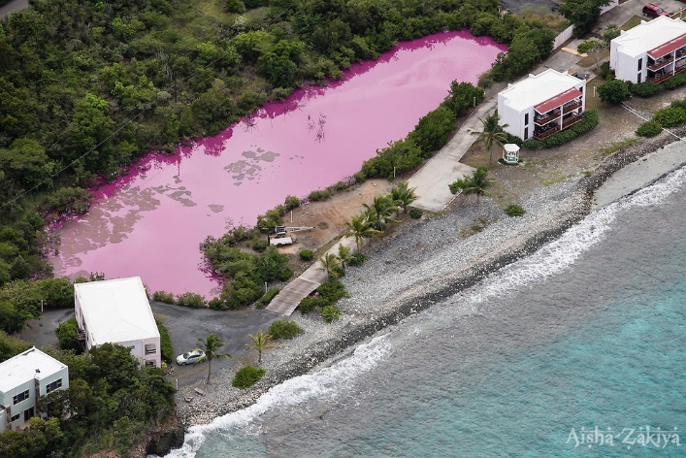
OCTOBER 30th:
2012:
The Virgin Islands Daily News revealed the salt pond in Cabrita Point area had turned a bright pink. Due to an irrigation system that had been moved, the runoff ended up in the pond. It created a nutrient rich environment for algae, which coupled with the high salinity water leading to the bright pink color water.
Courtesy of
Text: The Virgin Islands Daily News, October 30, 2012, page 3
Picture: http://aishazakiya.photoshelter.com/image/I0000ncsLxRZES6A

Slide 43

OCTOBER 31st:
1717:
The Danish West India Company ship, Jomfru Alette, was captured by a Swedish privateer on its way from Norway to Copenhagen. The ship was laden with goods destined for trade in the West Indies.
Courtesy of
Text: Today in VI History
Picture: http://www.hubert-herald.nl/VirginIsls.htm

Slide 44
To receive monthly complimentary electronic historical cultural calendars, kindly contact …..
Virgin Islands Department of Education
Division of Virgin Islands Cultural Education
ST. CROIX
2133 Hospital Street; St. Croix, VI 00820
Telephone Number: 340-773-1095 x: 7032
Fax Number: 340-773-4476
ST. THOMAS / ST. JOHN
Mailing Address: 1834 Kongens Gade; STT, VI 00802
Physical Address: J. Antonio Jarvis Annex; STT, VI 00802
Telephone Number: 340-774-0100 x: 2808, 2806, or 2804
Fax Number: 340-777-4342
Email Addresses: vbryson@stx.k12.vi; mmartin@sttj.k12.vi; alpbenjamin@sttj.k12.vi
Building Our Future Through
Education, History and Culture!

